Slide 1
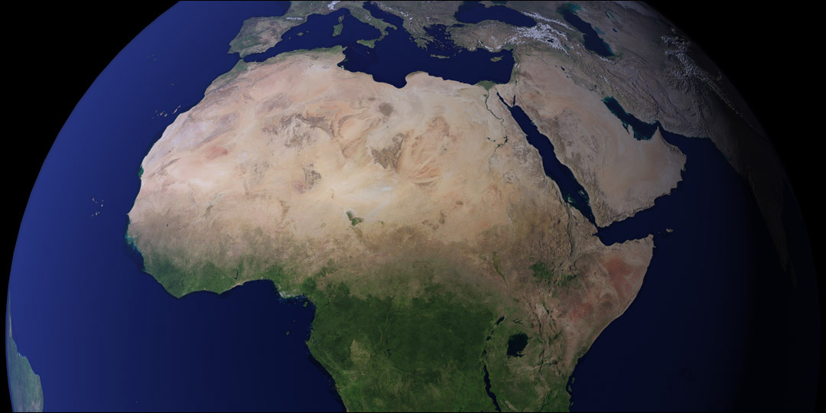
Intro to Earth Science

Slide 2
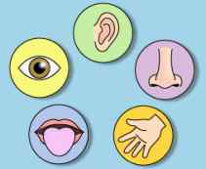
Observations, Inferences, Classification
What is used to make an observation?
the five senses

Slide 3
Scientific Instruments (Help with observations)
 | Common Instrument
Volume of Regular, Rectangular Objects (a box)
Volume of Irregularly Shaped Objects (rocks)
Mass
Distance
Time
ruler
graduated cylinder
scale
ruler
stop watch

Slide 4
After observations have been collected. What does it mean to
make an inference?
make an educated guess
(an hypothesis)

Slide 5
We use the observations made to classify objects.
Give some examples of how you use classification systems.

Slide 6
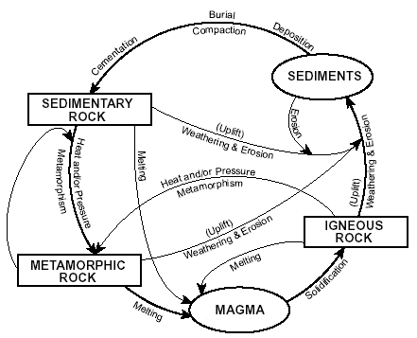
Give examples of how scientists
use classification systems.
Types of ROCKS

Slide 7
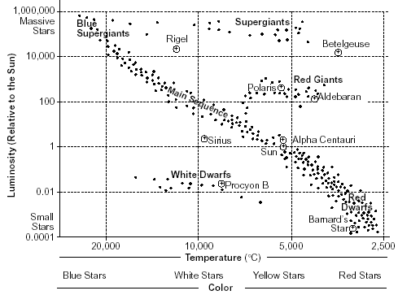
Give examples of how scientists
use classification systems.
Types of STARS

Slide 8
Complete pages 3 and 4 in Notes Packet

Slide 9
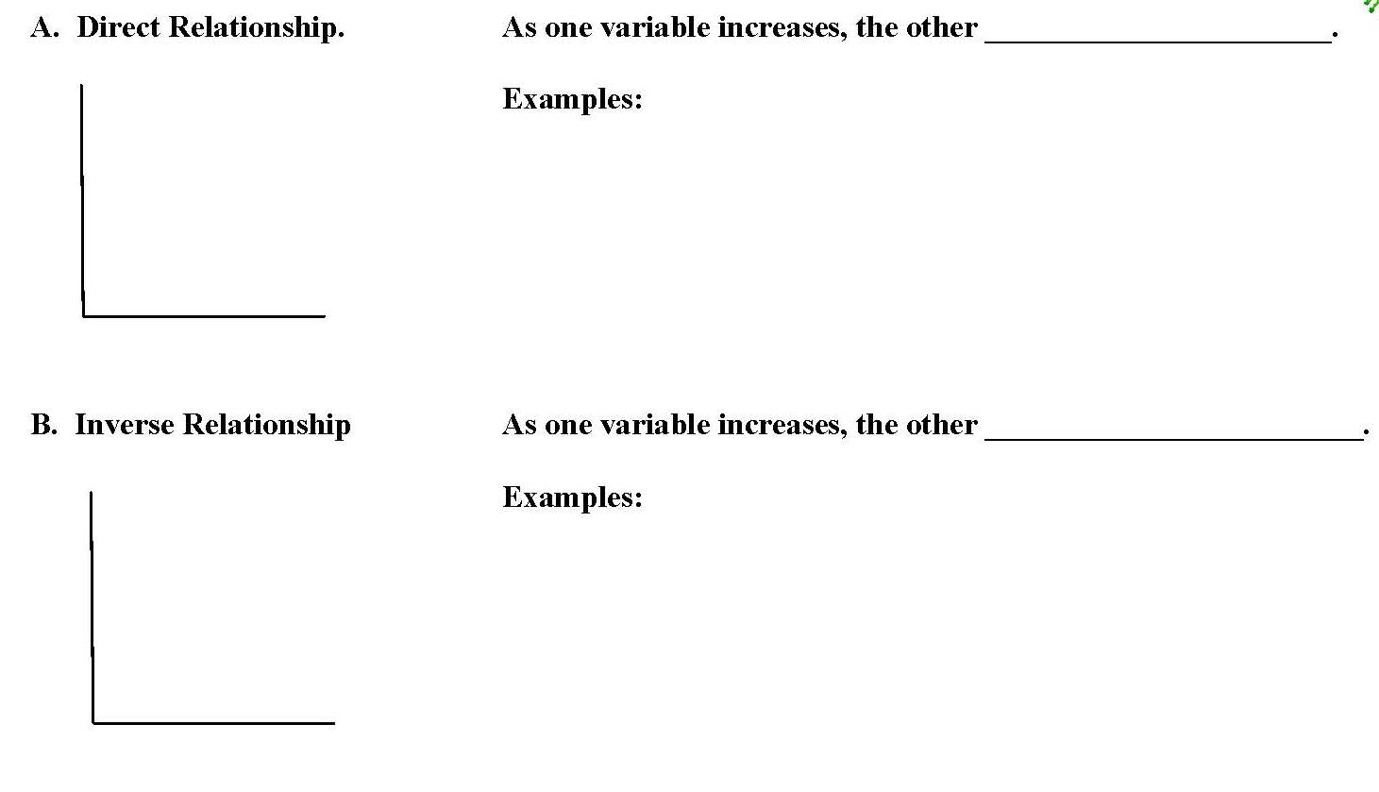
Graphical Relationships
increases
- Population vs. Pollution
- Hours you study vs. Grades
decreases
- Distance vs. Magnetic Attraction
- Elevation vs. Temperature

Slide 10
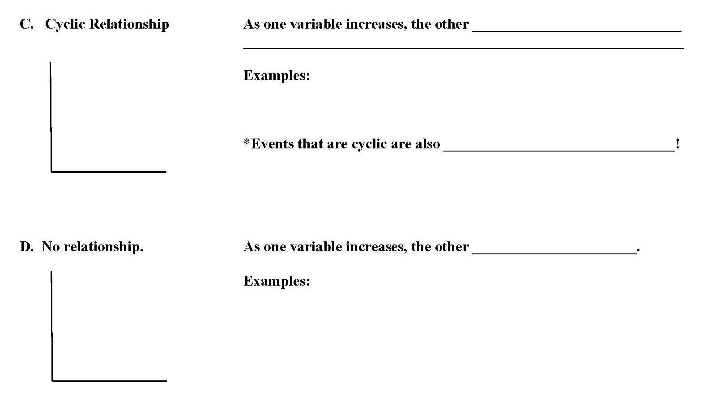
Changes in a Pattern
- Moon Phases
- Yearly Temperature
Predictable
Stays the same
- Time vs. Mass
- Times vs. # of Planets

Slide 11
Complete pages 6-9 in notes packet

Slide 12
Earth Science Math and You
(The Basic Math You Need to Know)
Rounding
Subtracting Time
Scientific Notation

Slide 13
Complete page 10- 11 in notes packet

Slide 14
How something changes over a period of time

Slide 15
Complete page 12 and 13 in notes packet

Slide 16
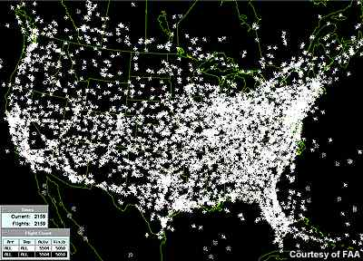
DENSITY:

Slide 17
- The amount of matter in a specific volume
- How tightly packed the atoms are
* Know the Density Triangle*

Slide 18
The same substance has the same density
Density does not change if a material is broken in half
You need to Remember This!!
Cutting or breaking an object does NOT change its density!

Slide 19
Complete pg 14 and 15 in Notes Packet

Slide 20
Temperature
Pressure
Rises
Less
Hot Air Balloon

Slide 21
As Temp. Increases Density Decreases

Slide 22
Phases of Matter & Density
During which phase of matter (solid,
liquid, or gas) are most materials:
most dense?
least dense?
solid
gas

Slide 23
Solid
Expands
3.98
1

Slide 24
Density
Mass
Volume
.2
Density =
0.5
=1
>1
Less
More

Slide 25
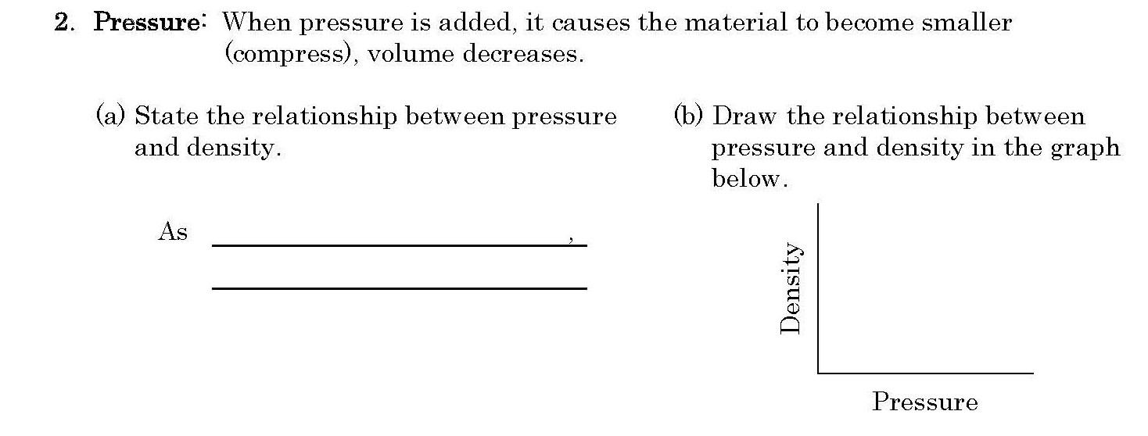
As Pressure Increases Density Increases

Slide 26
Complete pages 17– 22 in Notes Packet

