Slide 1
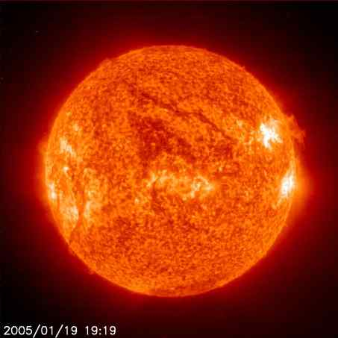
Energy in Earth Processes

Slide 2
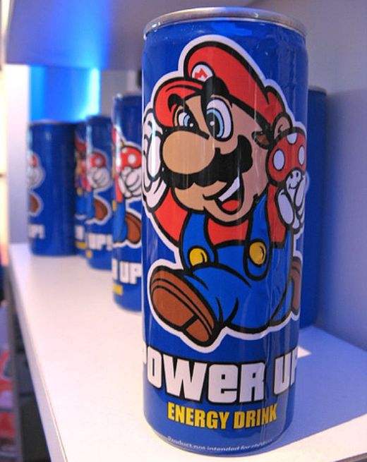
What is Energy?
Energy: The ability to do work
Everything that is done in the universe – involves the use or transfer of energy.

Slide 3
Types of Energy
1) Potential Energy:
stored energy
EXAMPLES
AT THE TOP OF A SKI SLOPE
WATER BEHIND A DAM

Slide 4
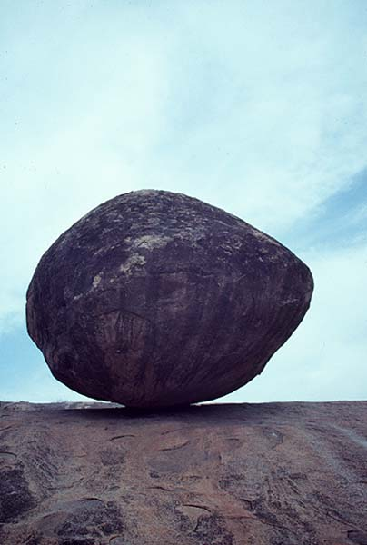

Slide 5
Types of Energy
2)Kinetic Energy
energy in motion
EXAMPLES
SKIING DOWNHILL
THROWING A BOWLING BALL
WATER FLOWING IN A RIVER

Slide 6
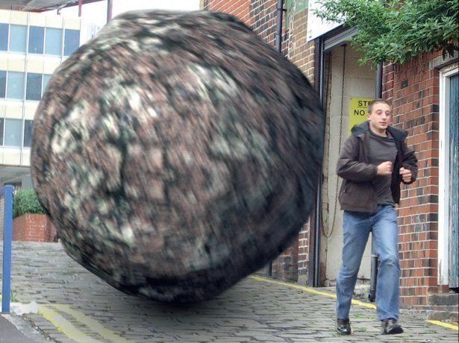

Slide 7
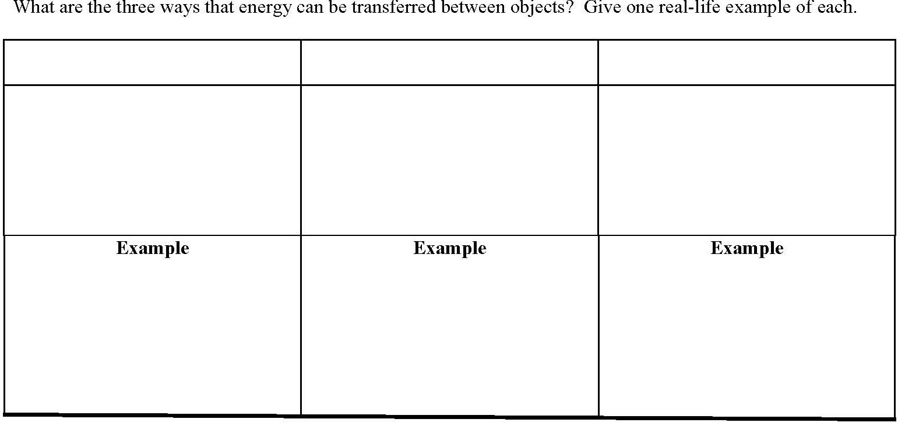
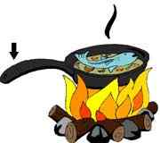
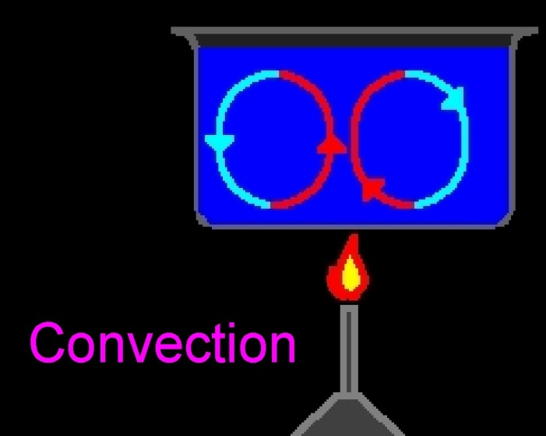
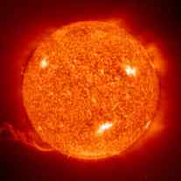
Conduction
Convection
Radiation
Transfer of energy due to collision of molecules. *Mostly in Solids*
Transfer of energy caused by differences in density. *In Liquids and Gasses*
Transfer of energy by electromagnetic waves. *In solids, liquids, gasses and empty space*
Warm, less dense = Rises
Handle on metal frying pan gets hot.
Light energy from the sun.
Microwave
Cool, more dense = Sinks

Slide 8
http://www.teachersdomain.org/resources/lsps07/sci/phys/energy/heattransfer/assets/lsps07_int_heattransfer/lsps07_int_heattransfer_swf.html

Slide 9
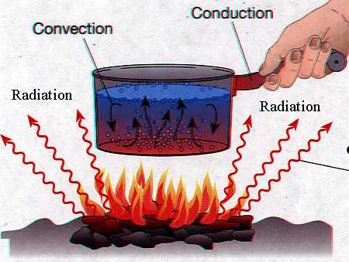

Slide 11
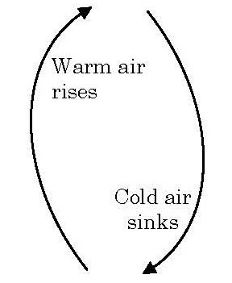
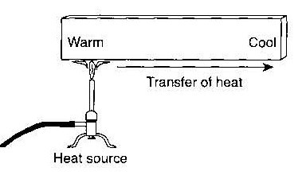
What type of Energy Transfer is going on???
Conduction
Convection

Slide 12
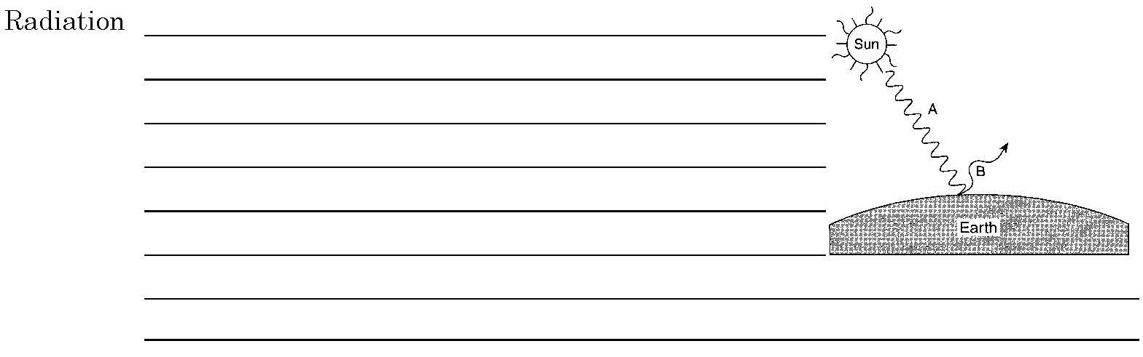
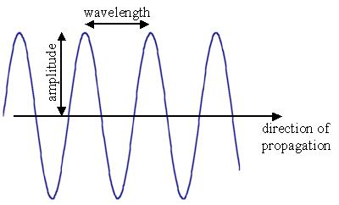
Electromagnetic Energy:
- Energy that is radiated in the form of a transverse wave.
-This is how we get energy from the sun.
- Difference between forms of electromagnetic energy is due to size of wavelength.
- Shorter wavelength= more powerful

Slide 13
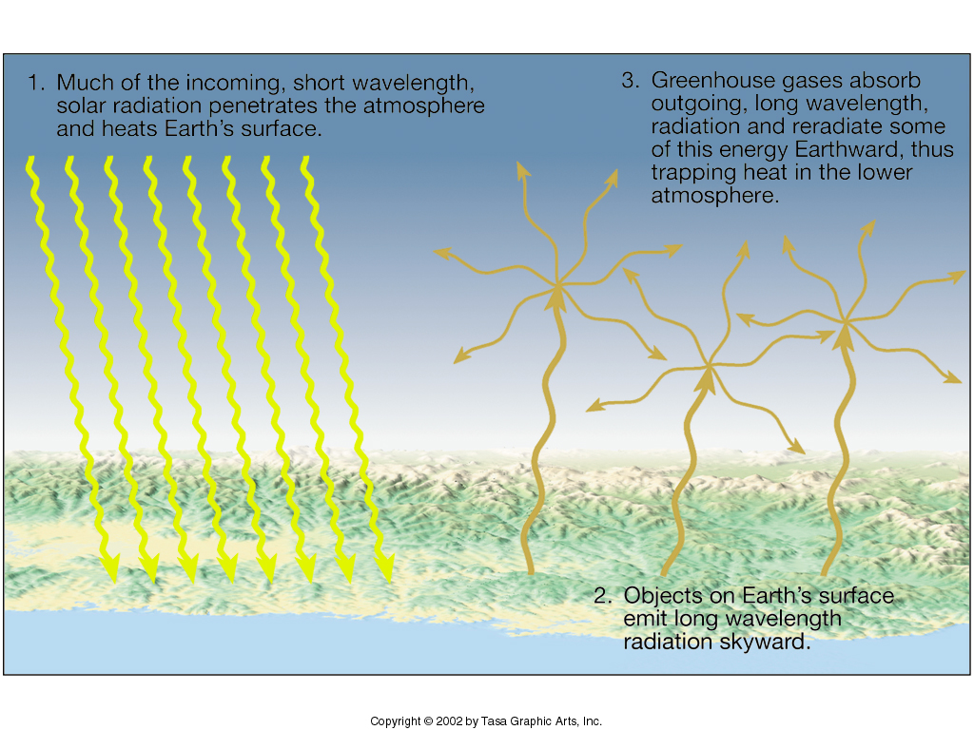

Slide 14
http://www.teachersdomain.org/asset/ess05_int_irgallery/
And video

Slide 15
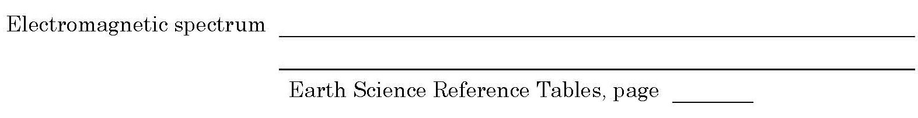
Range of radiation identified by wavelength.
14

Slide 18
When ELECTROMAGNETIC ENERGY (RADIATION) REACHES EARTH it is …
Reflected – bounced back at the same angle they arrived
Scattered – reflected in various directions
Refracted – bent
Transmitted – pass through the material
Absorbed (taken in as heat energy)

Slide 19
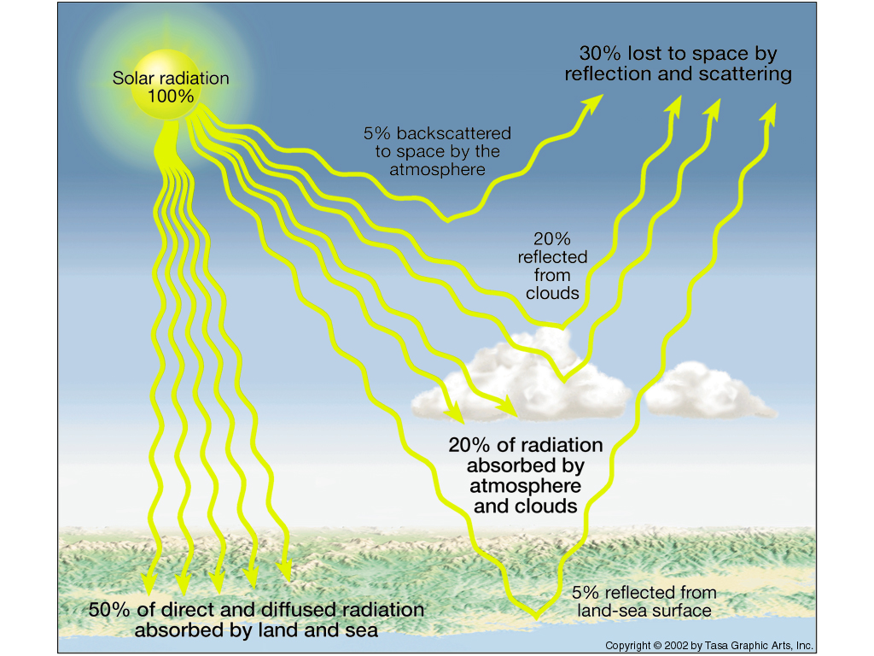

Slide 20
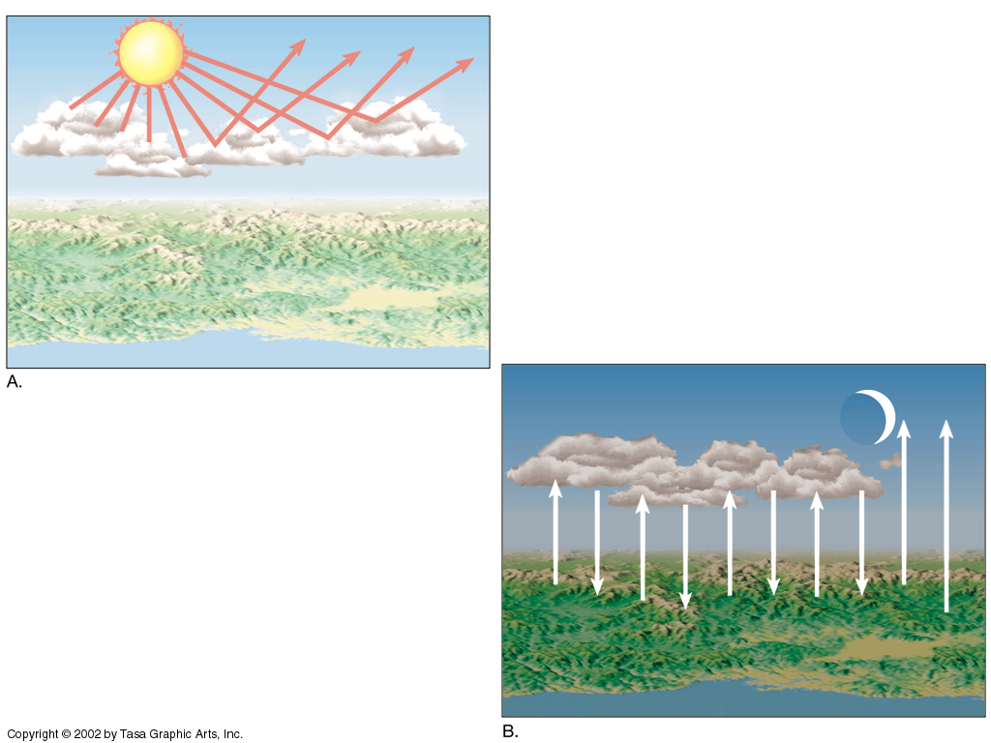

Slide 21
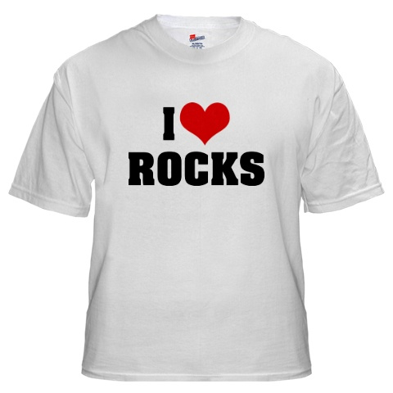
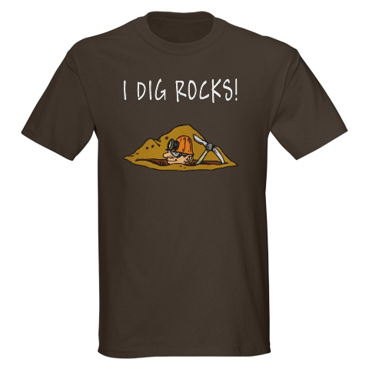
Surface Properties and Absorption/Reflection
On a hot summer day, what color clothes do you wear?

Slide 22
The Best Absorbers are
dark & rough
The Best Reflectors are
light colored & smooth

Slide 23
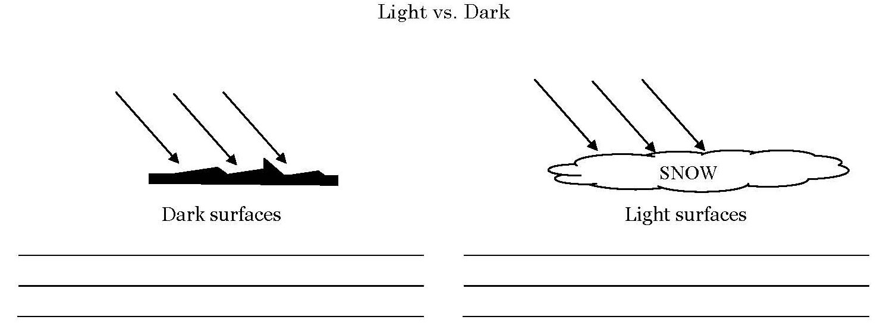
Absorb Radiation from the sun.
Reflect Radiation from the sun.

Slide 24
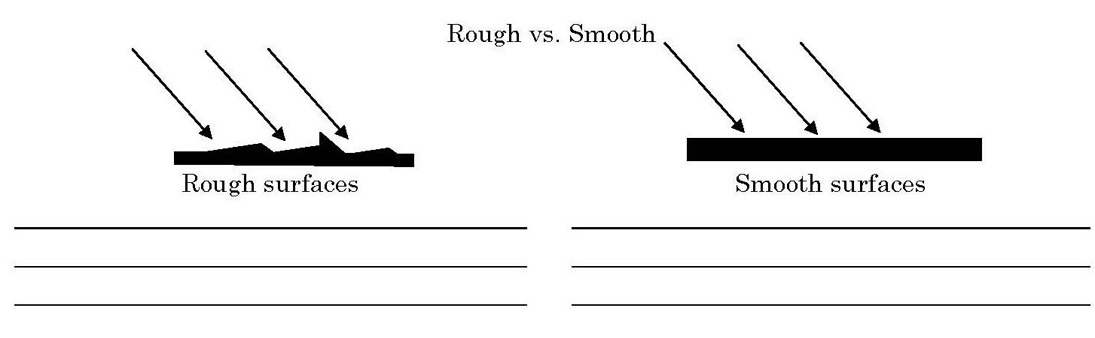
Absorb Radiation from the sun.
Reflect Radiation from the sun.

Slide 25

What is a better absorber of radiation???
Land is a better absorber and radiator of radiation from the sun.
Most of the time land is darker and rougher then water.
Ex: Dark forest canopy, blacktop.

Slide 26
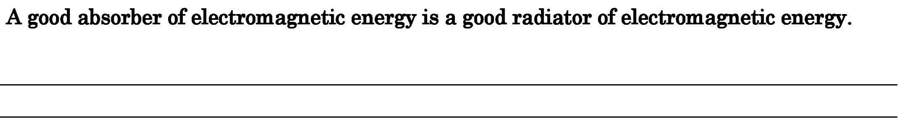
Dark and Rough are good absorbers of energy and also good radiators.

Slide 27
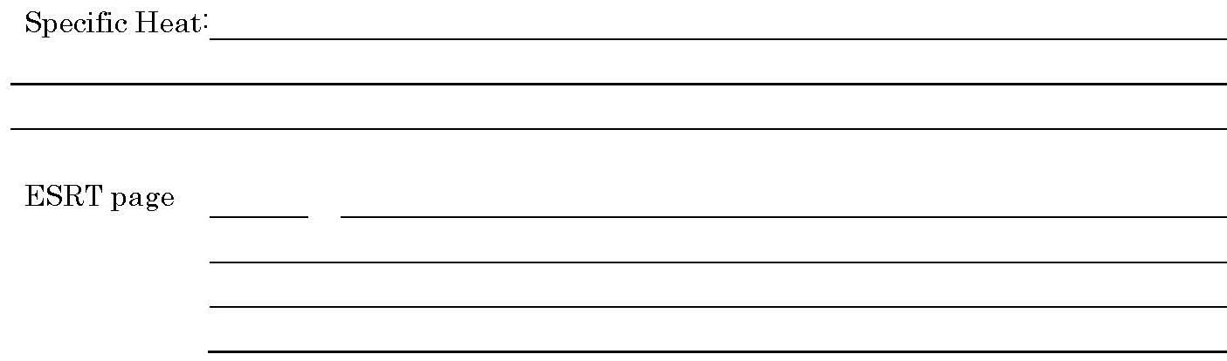
The resistance of a material to heating up or cooling off.
1
Water has a high specific heat. It heats up ____________ and cools off _____________.
SLOWLY
SLOWLY

Slide 28
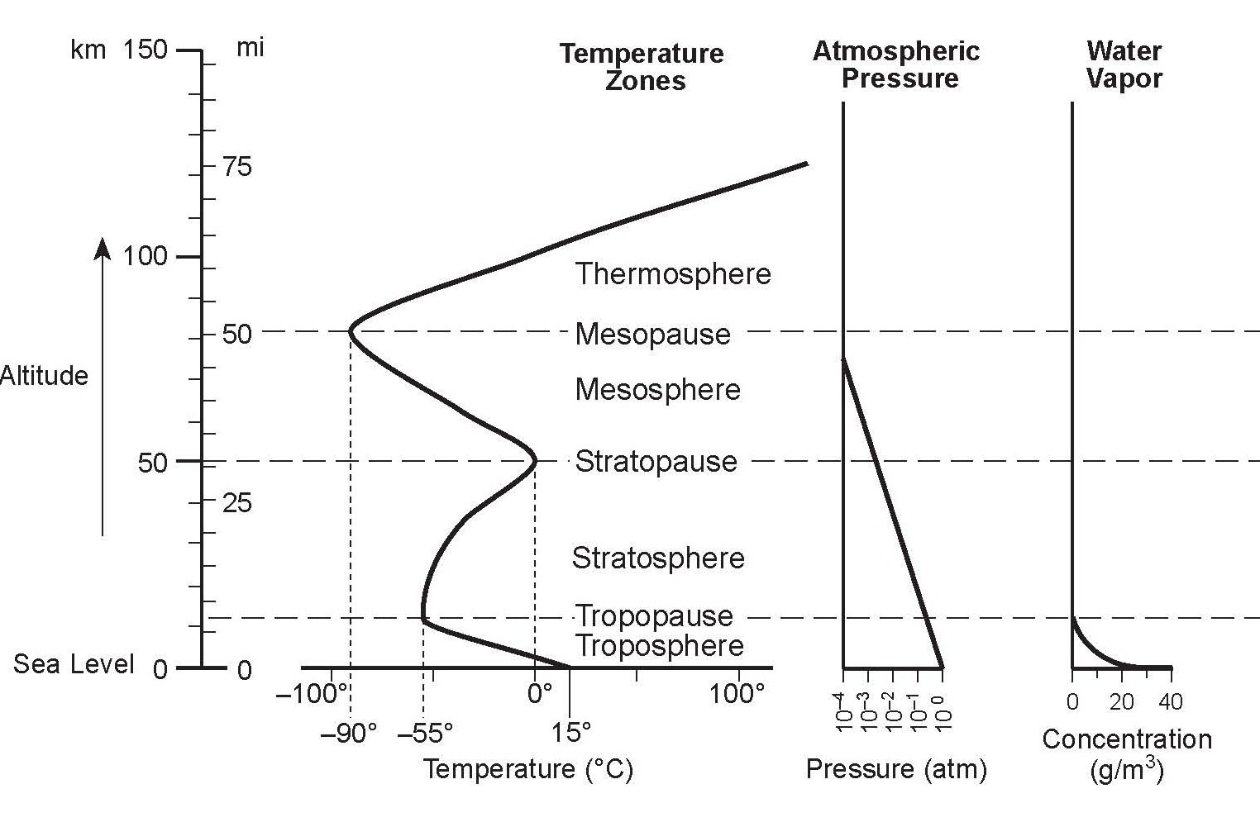

Slide 29
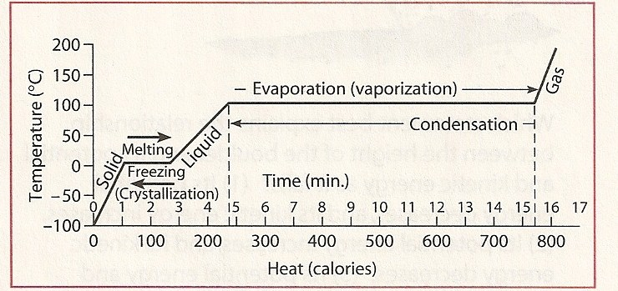
Heating of Water
Label the following terms in their correct places: condensation, vaporization, solidification, melting.

Slide 31

Heat Energy and Changes of State
1) Melting
The changing of a solid to a liquid

Slide 32
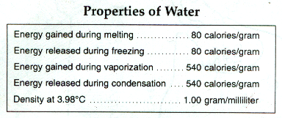
Reference Table page 1

Slide 33
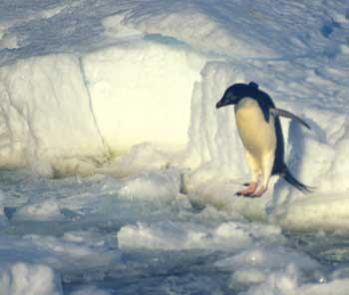
ICE

Slide 34
Heat Energy and Changes of State
2) Solidification:
(Freezing)
The changing of a liquid to a solid.

Slide 35
Reference Table page 1

Slide 36
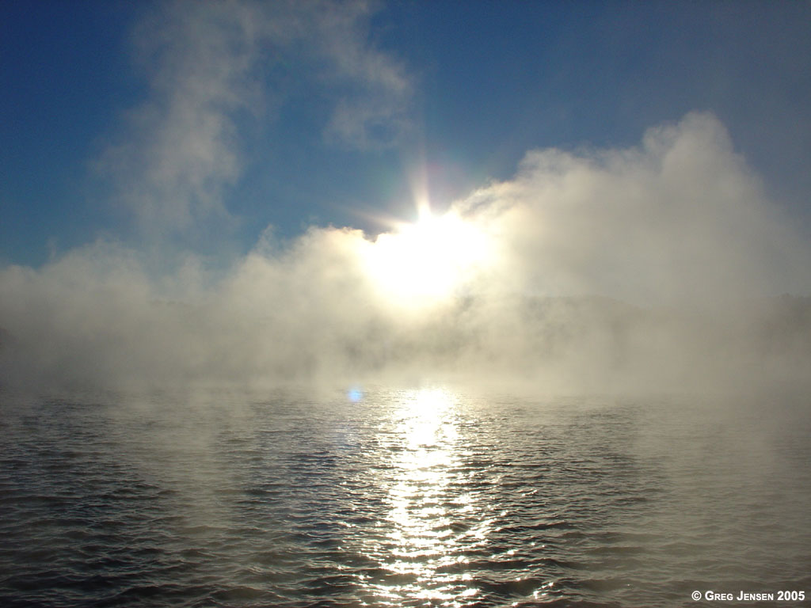
FOG, STEAM

Slide 37
Heat Energy and Changes of State
3) Evaporation, or Vaporization:
The changing of a liquid to a gas, or water vapor.

Slide 38
Reference Table page 1

Slide 39
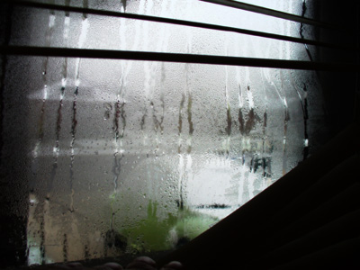

Slide 40
Heat Energy and Changes of State
4) Condensation:
The changing of a gas, or vapor to a liquid.

Slide 41
Reference Table page 1

Slide 42
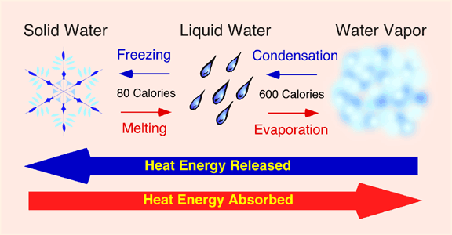

Slide 43
Heat Energy and Changes of State
Sublimation:
- The changing of a gas directly to a solid, or from a solid directly to a gas.
- Without going through a liquid state

Slide 44
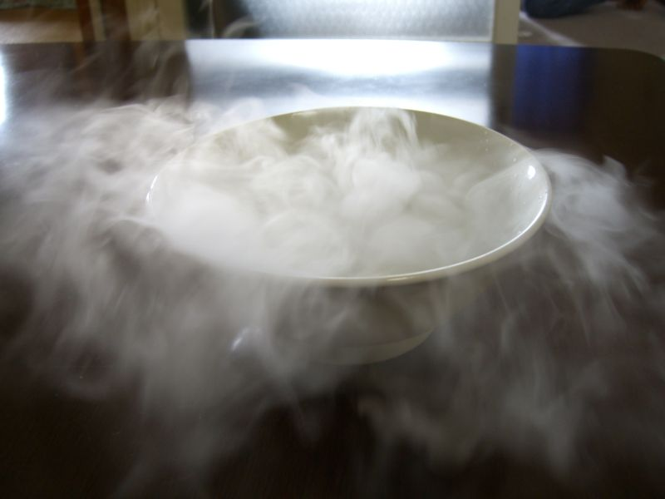

Slide 45
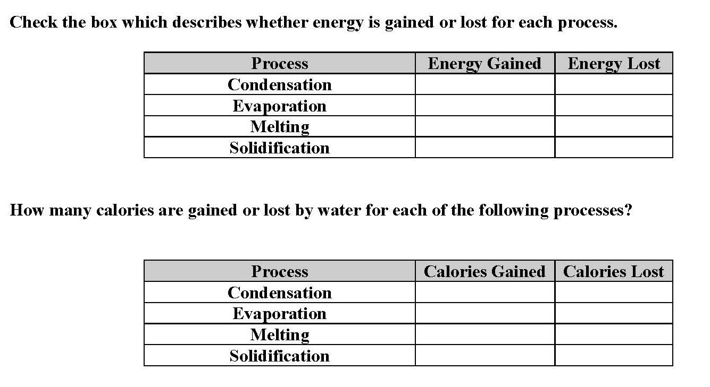
Properties of Water ESRT pg 1

Slide 46
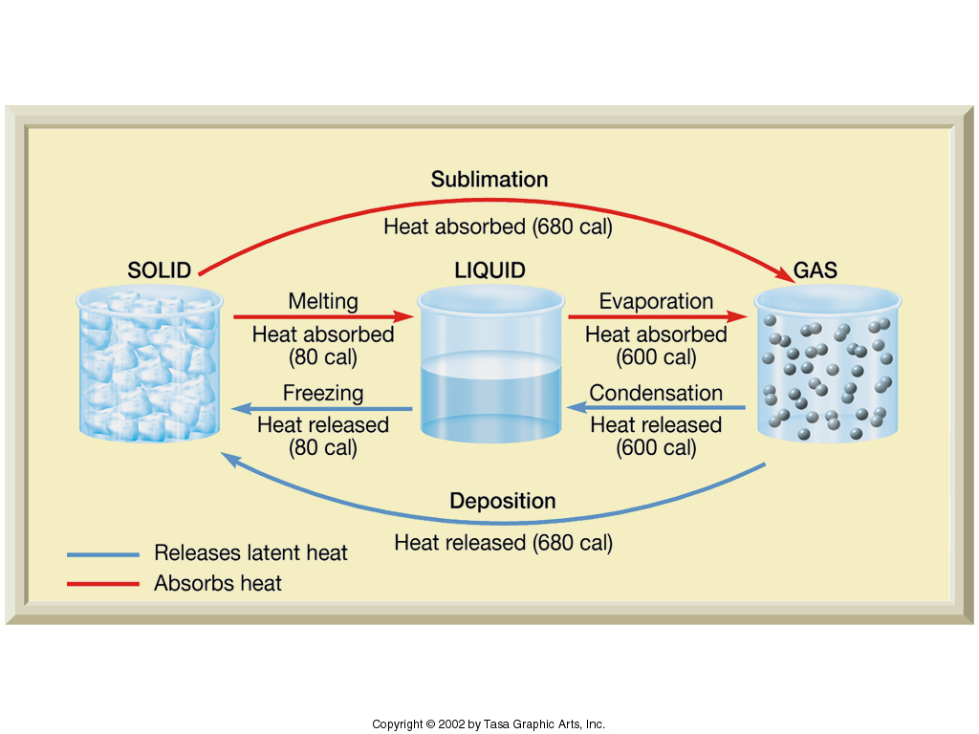
Changes in state of water.

Slide 47
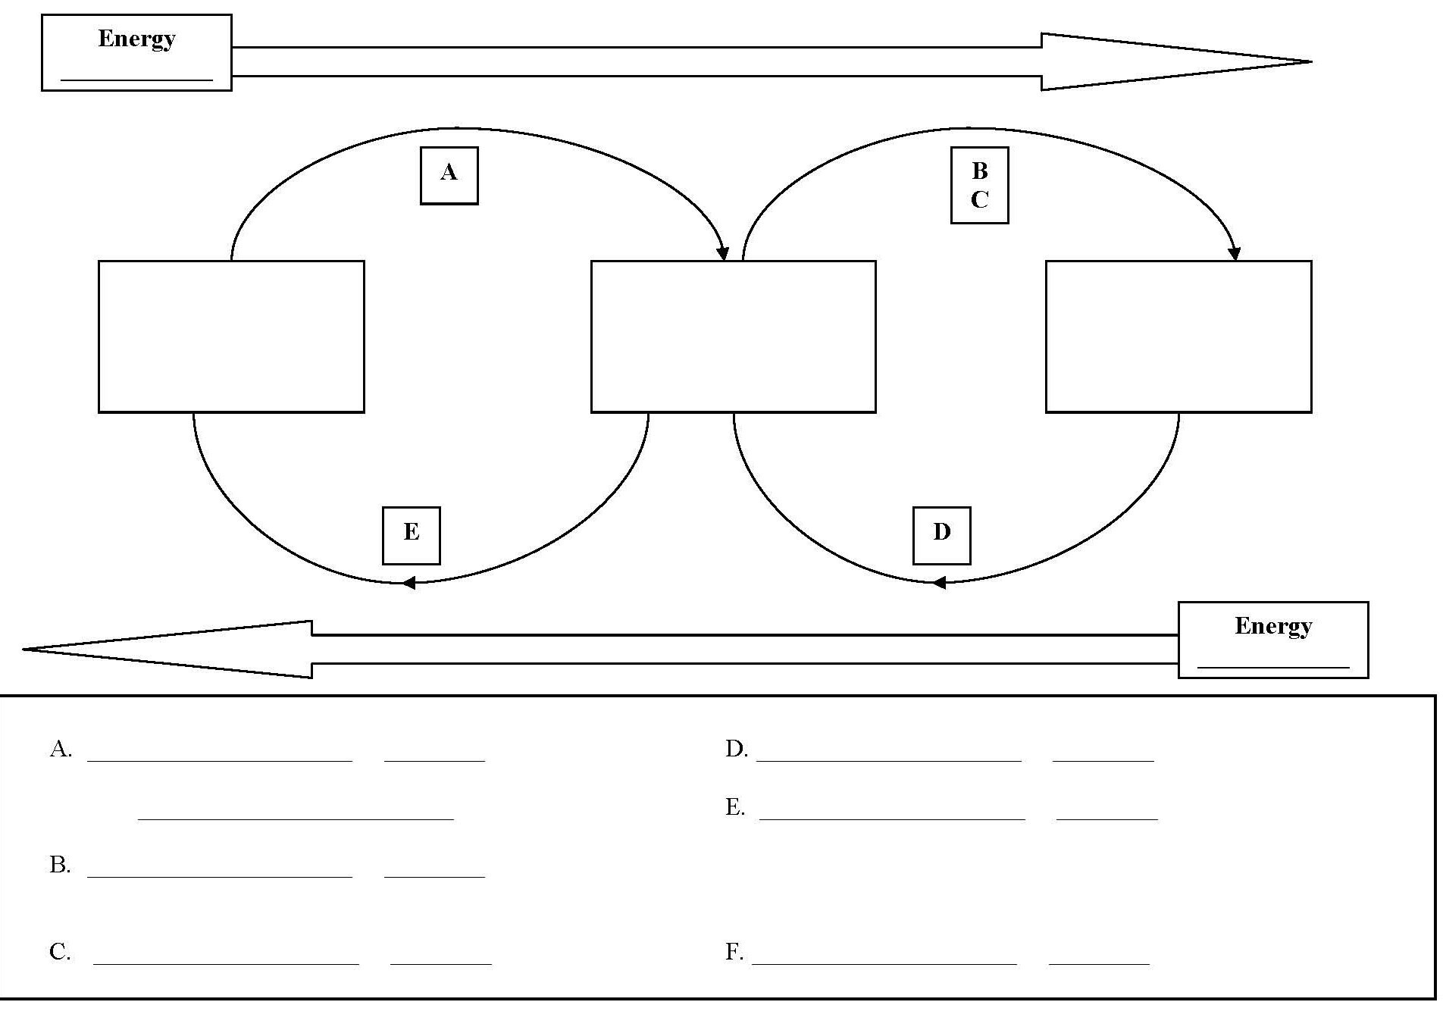

Slide 48
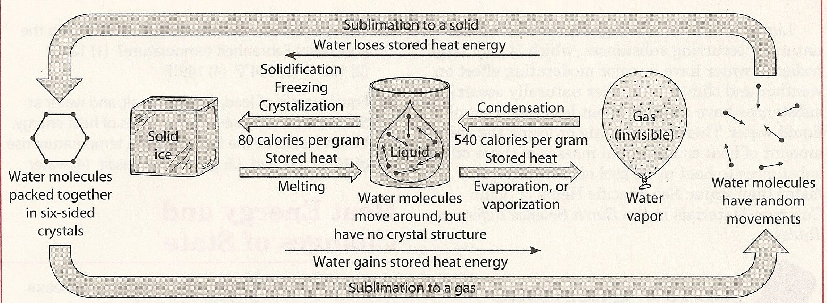

Slide 49
Transfer of Energy
Dynamic Equilibrium: At dynamic equilibrium a region loses and gains equal amounts of energy.
Example : Temp. remains constant

Slide 50
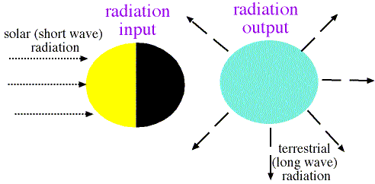
RADIATION BALANCE
DYNAMIC EQUILIBRIUM
INPUT = OUTPUT
Is global warming changing the balance???????

Slide 51
END

