Slide 1
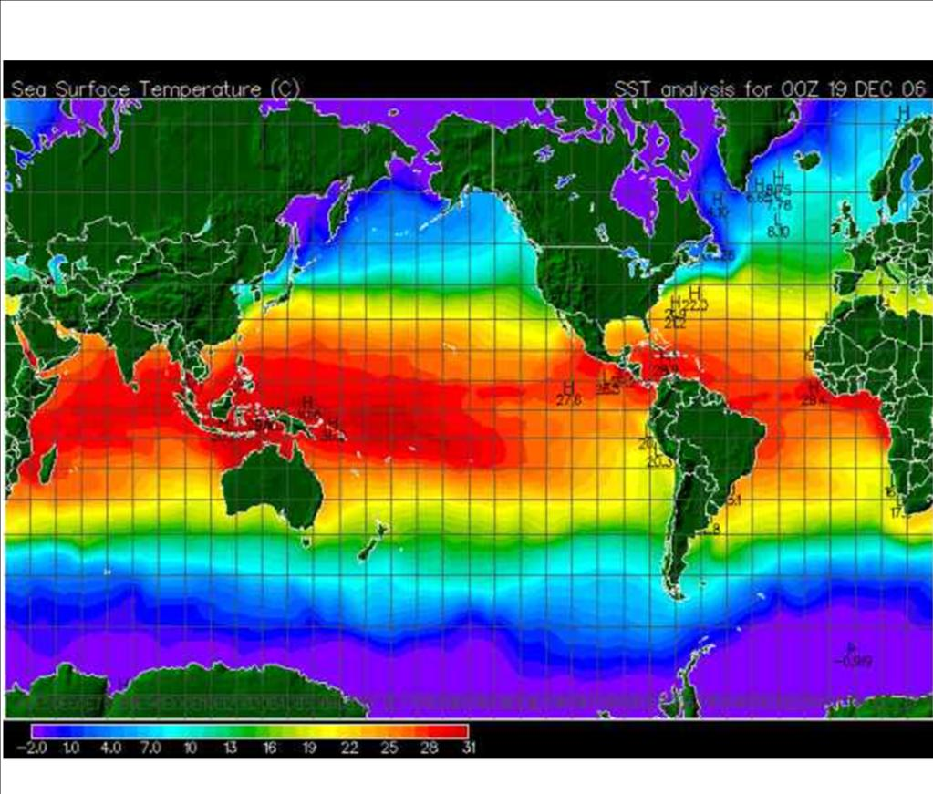
Climate and Seasons

Slide 2
Climate Factors
Identify five factors
that affect climate
and explain
how each
affects climate.

Slide 3
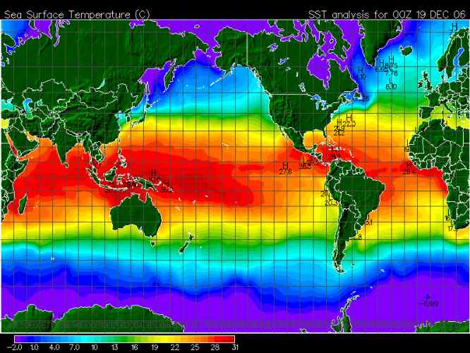
1)
Latitude

Slide 4
As latitude ________, the average
annual temperature _________.
increases
decreases
Temperature
0° Latitude 90°

Slide 5
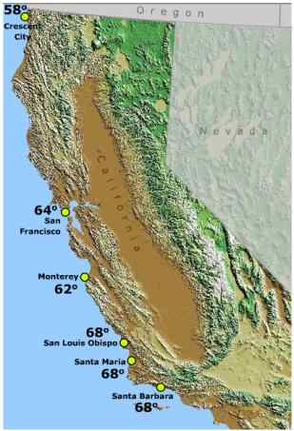
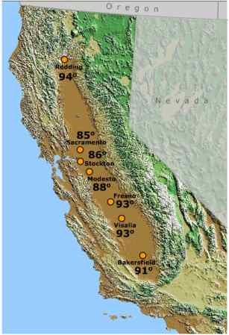
2)
Closeness to Large Bodies of Water

Slide 6
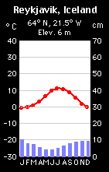
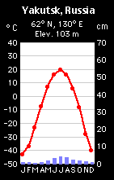
Coastal
Inland

Slide 7
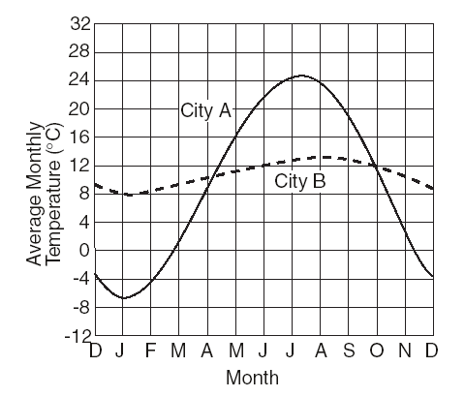
How does closeness to a large
body of water affect climate?
Water __________ the temperature.
_______ summers. _______ winters.
moderates
Cooler
Warmer
Cities A & B are located at the same latitude.
City B is closer to a large body of water.
Its temperature line is flatter (moderated, smaller temp. range).

Slide 8
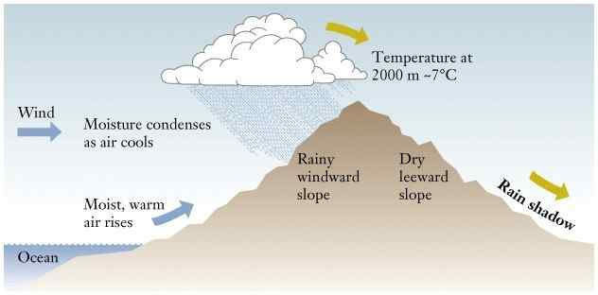
Orographic Effect
3)

Slide 9
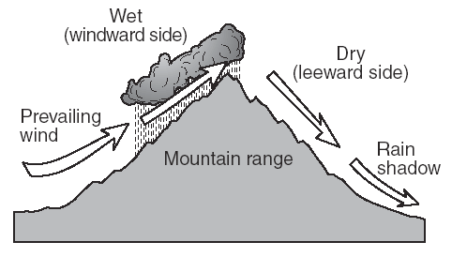
How does the
Orographic Effect
affect climate?
Windward Side: ___________
Leeward Side: _____________
cool, moist
warm, dry

Slide 10
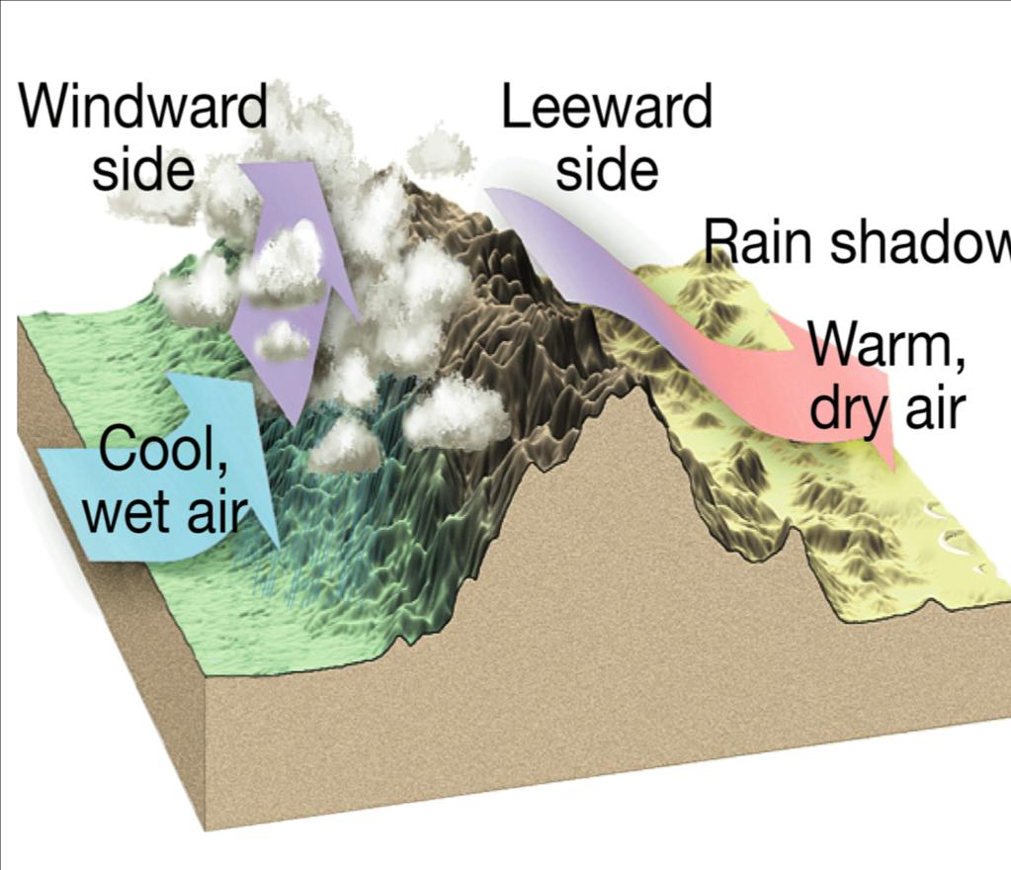

Slide 11
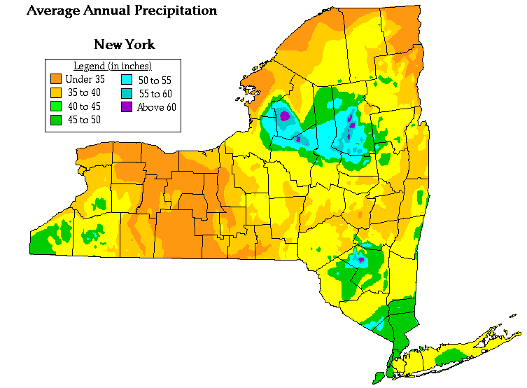
The leeward sides of the Adirondacks & Catskills receive much less precipitation
The windward sides of the Adirondacks & Catskills receive a great deal more precipitation

Slide 12
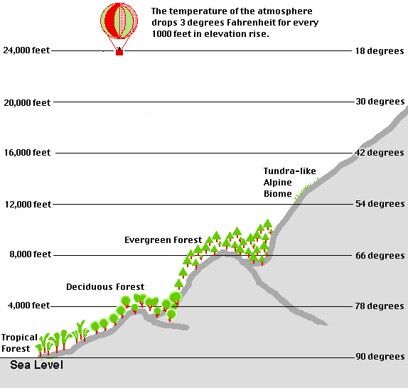
4))
Elevation

Slide 13
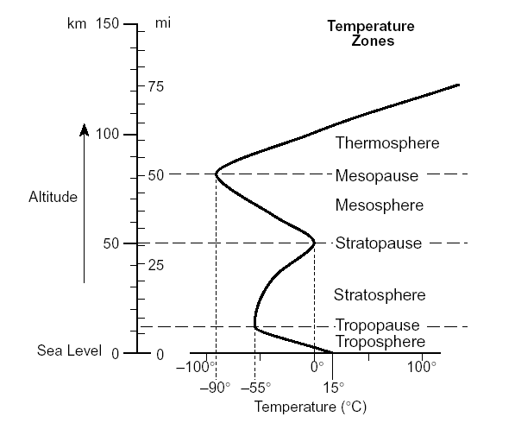
Elevation
Page 14 of the ESRTs
We live in the troposphere. Temperature decreases
with elevation.

Slide 14
How does elevation
affect climate?
As elevation _________, the average
annual temperature __________.
increases
decreases
Temperature
Elevation

Slide 15
5)
Ocean Currents
ESRT pg 4

Slide 16
How do ocean currents
affect climate?
Warm Currents: warmer climate
Cold Currents: cooler climate

Slide 17
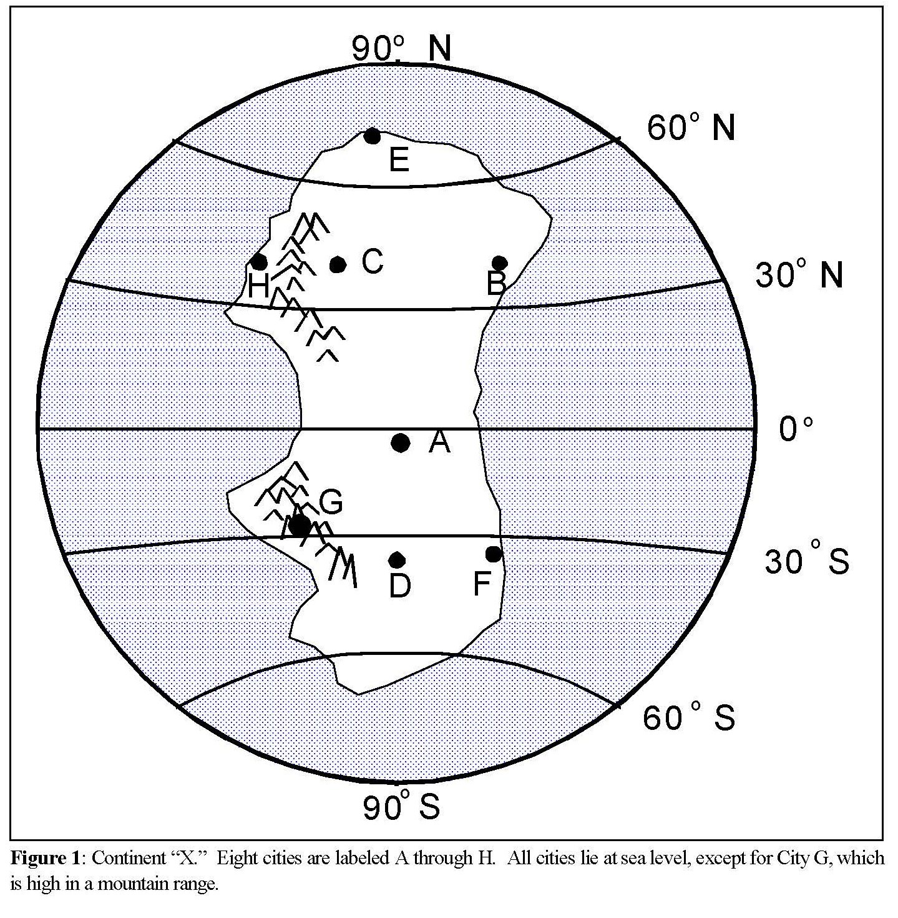
Factors that affects the Climate of an Imaginary Continent.

Slide 18
Sun's Energy & Climate
According to the graph below,
what wavelength
of energy does the Earth
receive in the greatest intensity?
visible light

Slide 19
Name the primary gas
which absorbs ultraviolet (UV)
from the sun.
ozone

Slide 20
Sun's Energy & Climate
Why is the ozone
layer important?
It protects the Earth from UV which damages crops and
causes cancer in humans.

Slide 21
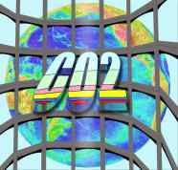
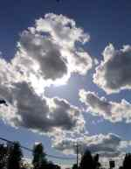
Name the three primary gases
which absorb infrared (IR) energy
methane
water vapor

Slide 22
Sun's Energy & Climate
Why is it warmer on a
cloudy night than
on a clear night?
Clouds (H₂O vapor) absorb IR energy radiated by the Earth. On a clear night, the IR energy escapes back into space.

Slide 23
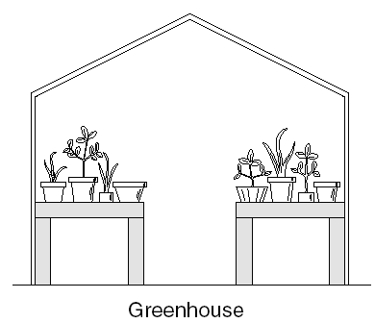
Explain the greenhouse effect. Include a diagram
which shows the change in wavelength.

Slide 24
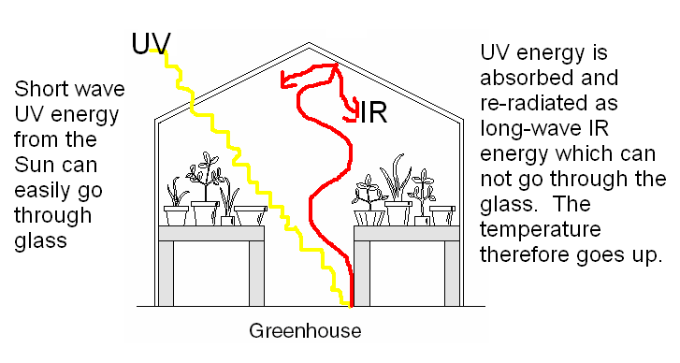
Explain the greenhouse effect. Include a diagram
which shows the change in wavelength.

Slide 25
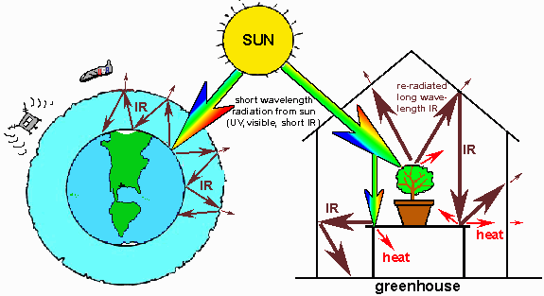
Just like a greenhouse, the gases in
the atmosphere ---especially CO₂ ---
absorb re-radiated infrared energy.

Slide 27
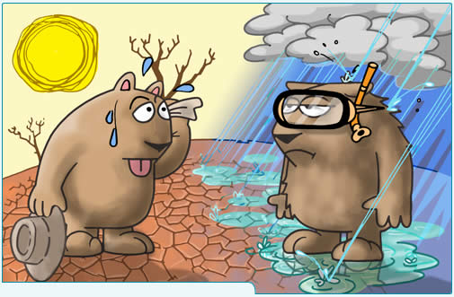
Climate Change

Slide 28
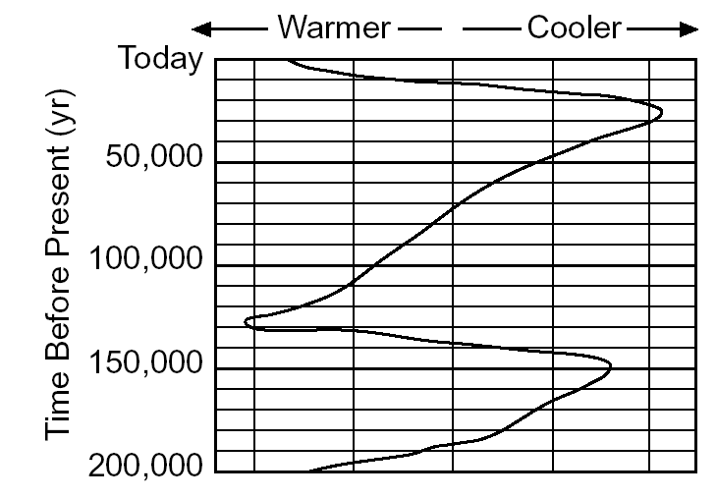
Ice Ages

Slide 29
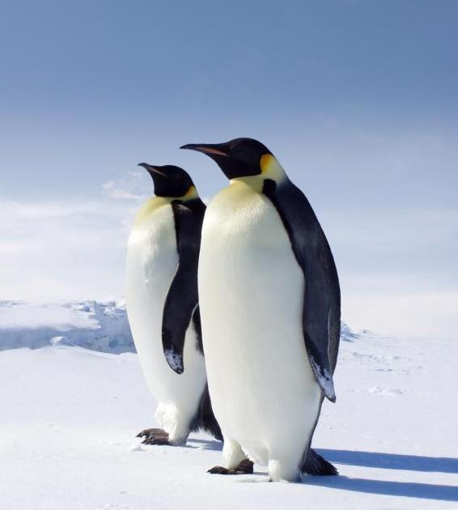
Ice Ages
Ice Ages are cyclic.
The last one occurred
~12,000 years ago
The exact cause of
what triggers an ice age
is not known

Slide 30
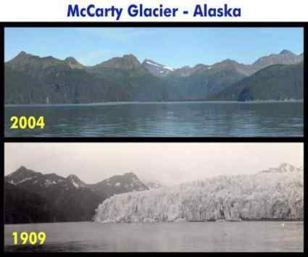
Global Warming

Slide 31
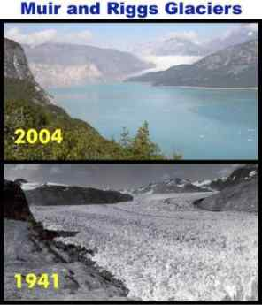

Slide 32
Global Warming
Average global temperatures
are increasing.
Glaciers are melting.
Ocean levels are rising.
Warming is natural.
Humans are speeding up the process
through increased levels of
carbon dioxide (CO₂)

Slide 33
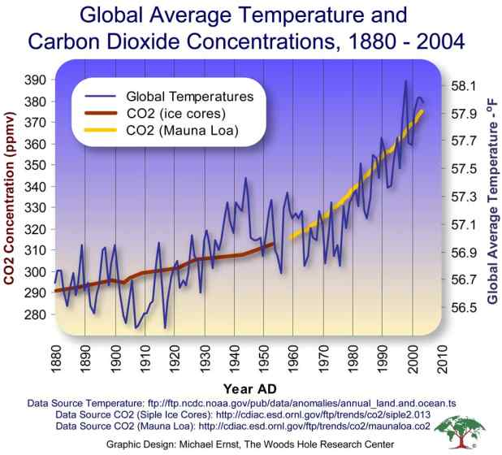

Slide 34
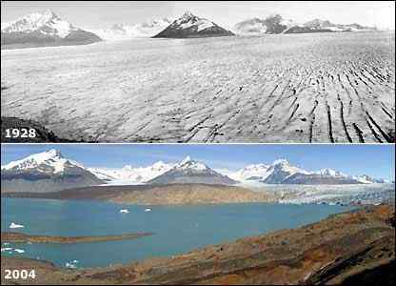

Slide 35
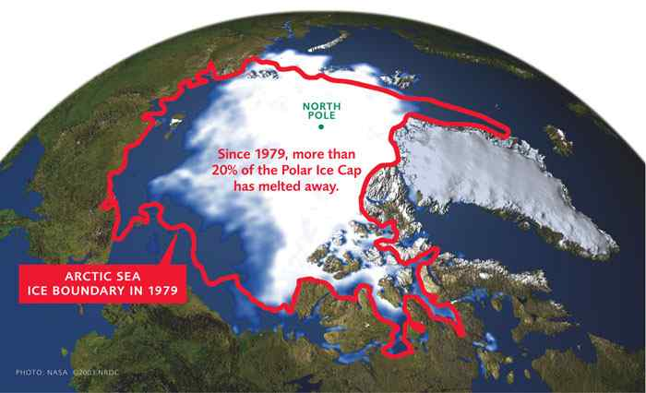

Slide 36
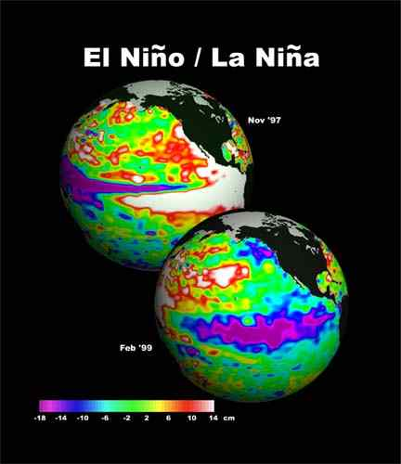

Slide 37
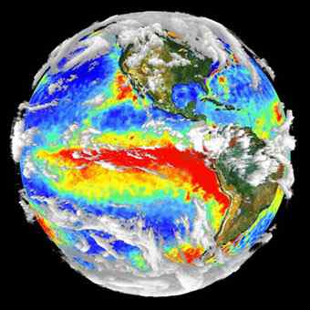
El Niño
A warming of the
Pacific Ocean.
Winters:
West = Stormy
South = Cold, wet
Northeast = warmer

Slide 38
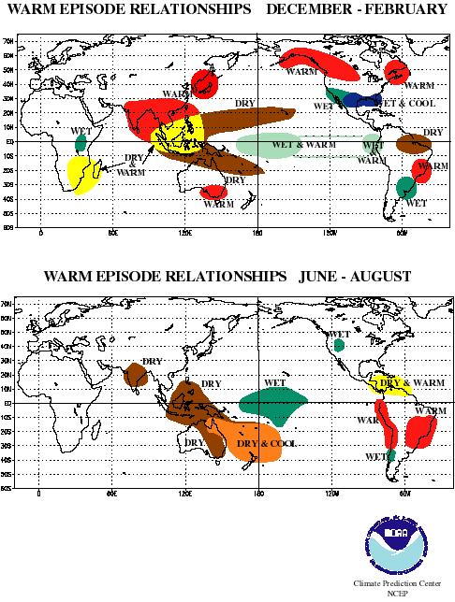

Slide 39
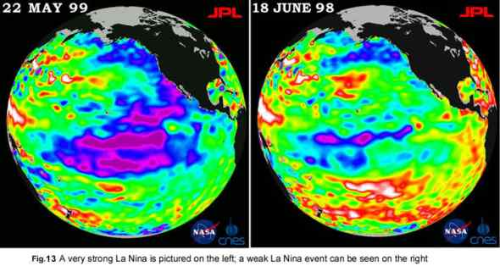
La Niña
A cooling of the Pacific Ocean.
Dry in southeast. Cool, wet in northwest.

Slide 40
Seasons
Summer
Winter
Fall
Spring

Slide 41
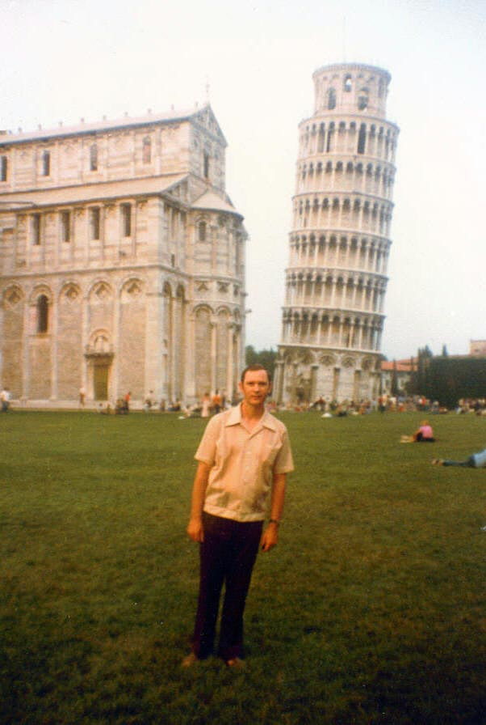
Reasons for the Seasons
23.5 °
Cause different latitudes to have different amounts of day light.

Slide 42
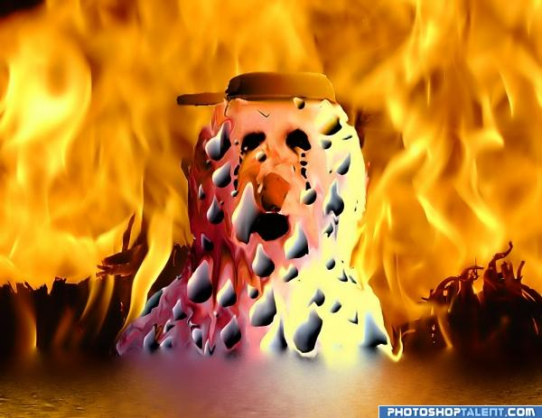
Insolation:
- Greater angle and duration of insolation = warmer temperatures.
- Greatest angle of incidence is 90 °
Equator
- Found at the ____________

Slide 43
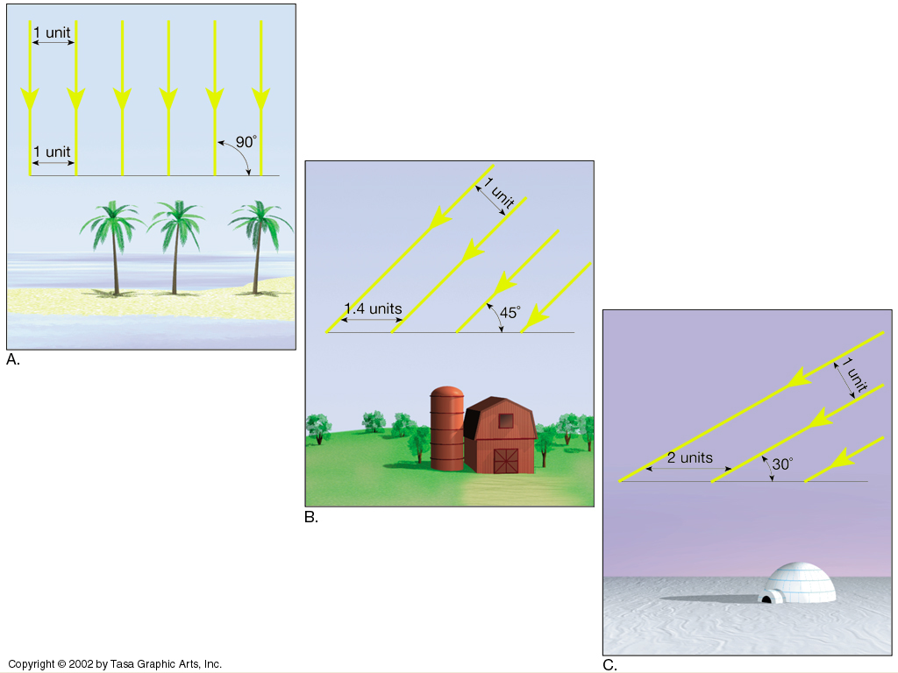

Slide 44
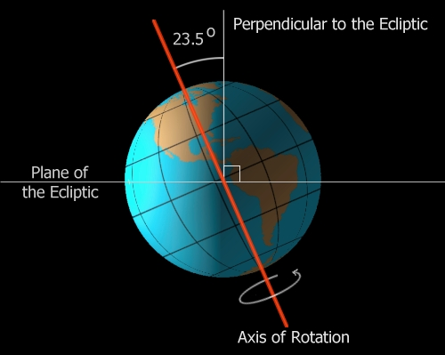
For the northern hemisphere
Summer: Northern Hemisphere is tilted toward to sun = greatest amount of insolation.
Winter: Northen Hemisphere tilted away from sun = least amount of insolation.

Slide 45
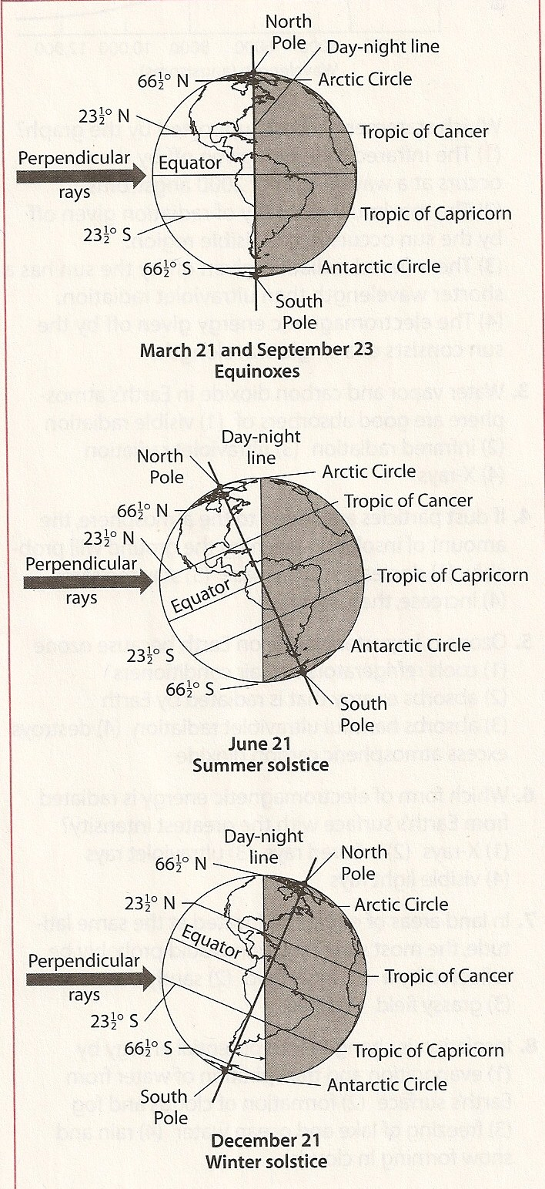
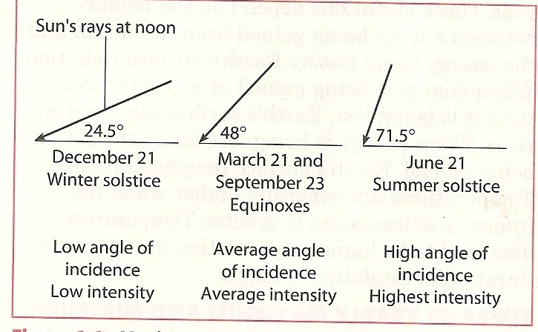

Slide 46
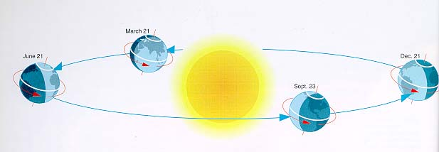
Earths orbit around the sun.

Slide 47
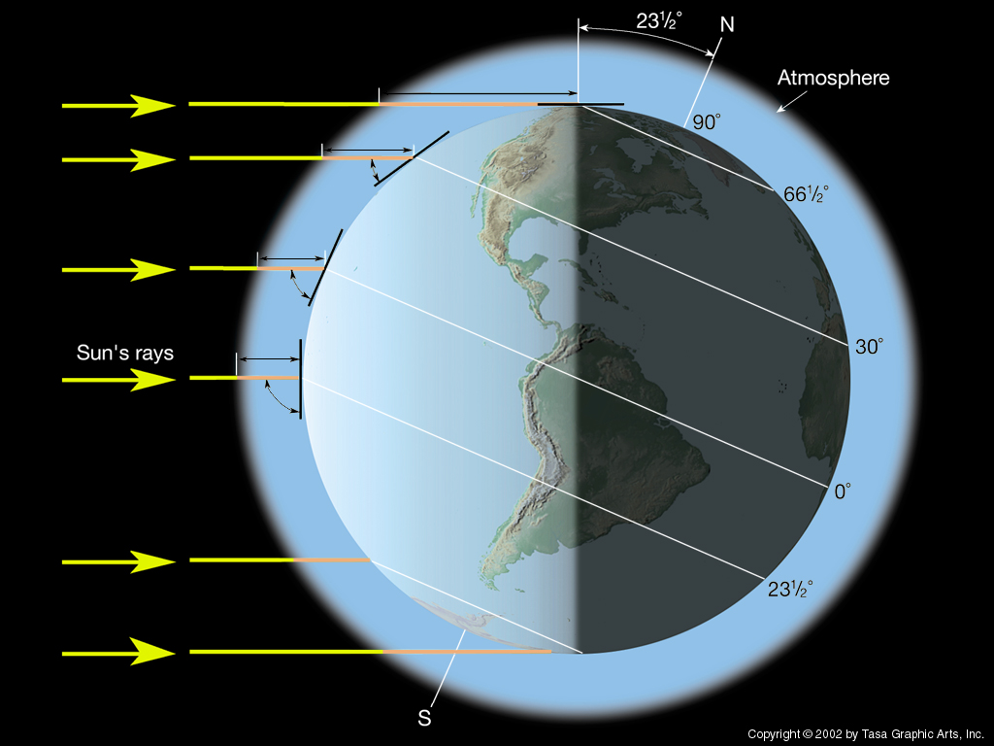
- Earth’s direction of tilt changes as Earth revolves around the sun.
- If the northern hemisphere is tilted towards the sun = summer time in northern hemisphere

Slide 48
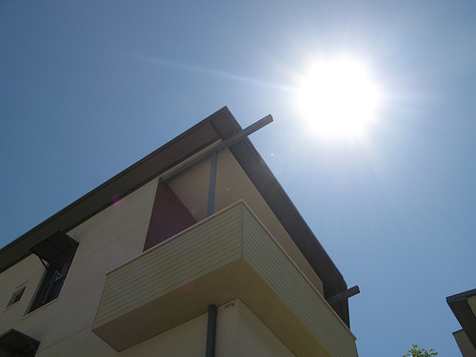
Altitude of the Noon Sun & Path through the Sky
- When the sun reaches its highest point in the sky
- NEVER directly overhead in New York
*Sun is always to the south in the Northern Hemisphere*

Slide 49
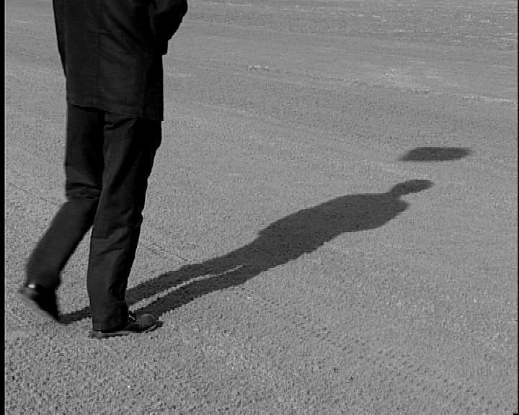
- Longer when the sun is lower in the sky.
- Direction at noon depends on latitude.

Slide 50
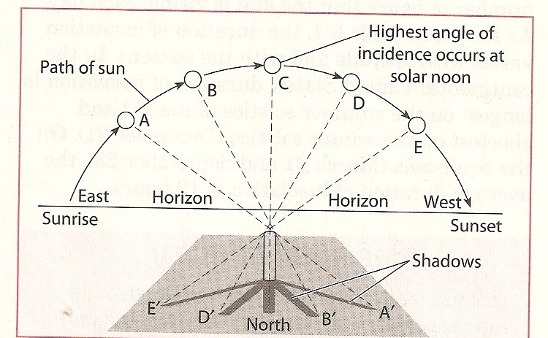

Slide 51
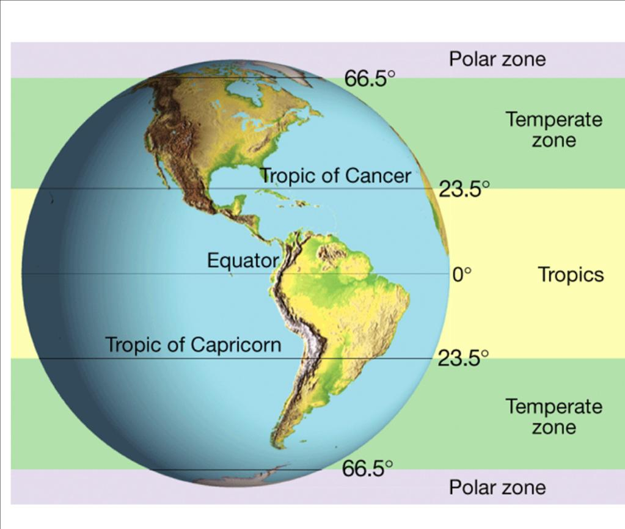
Any location between 23.5 ° N and 23.5 ° S of the Equator.

Slide 52
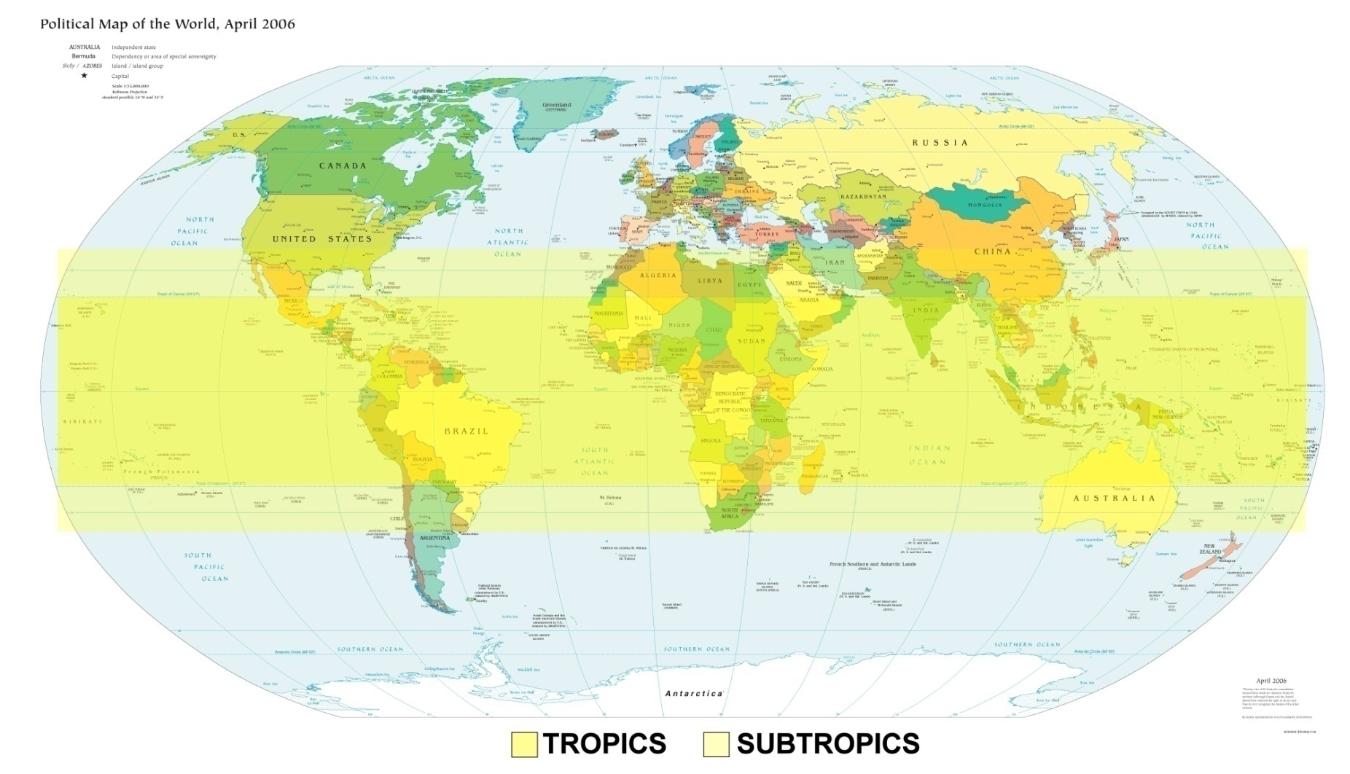
The last place North or South of the Equator where the sun is directly overhead (23.5 ° N and South of Equator)

Slide 53
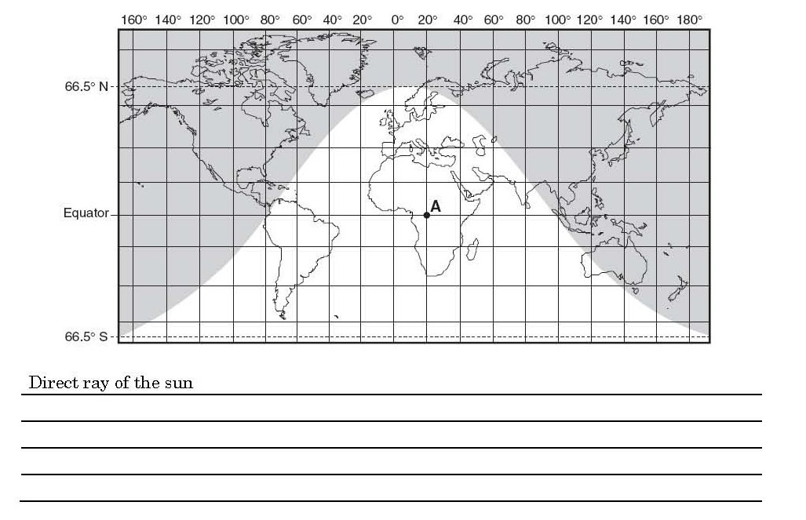
- Also known as sun’s vertical rays.
- Occurs when sun is directly overhead (at zenith)
- Never occurs in New York State

Slide 54
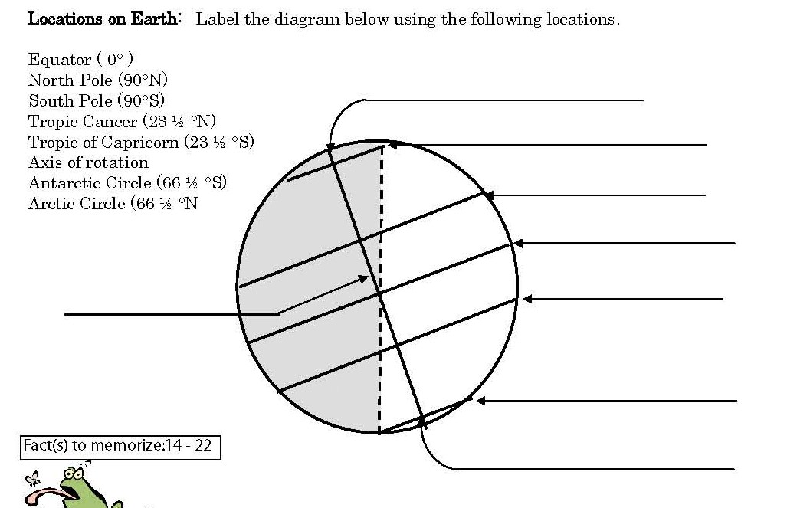
North Pole (90 ° N)
Arctic Circle ( 66.5 ° N)
Tropic of Cancer (23.5 ° N)
Equator (0 °)
Tropic of Capricorn (23.5 ° S)
Axis of rotation
Antarctic Circle 66.5 ° S)
South Pole (90 ° S)

Slide 55
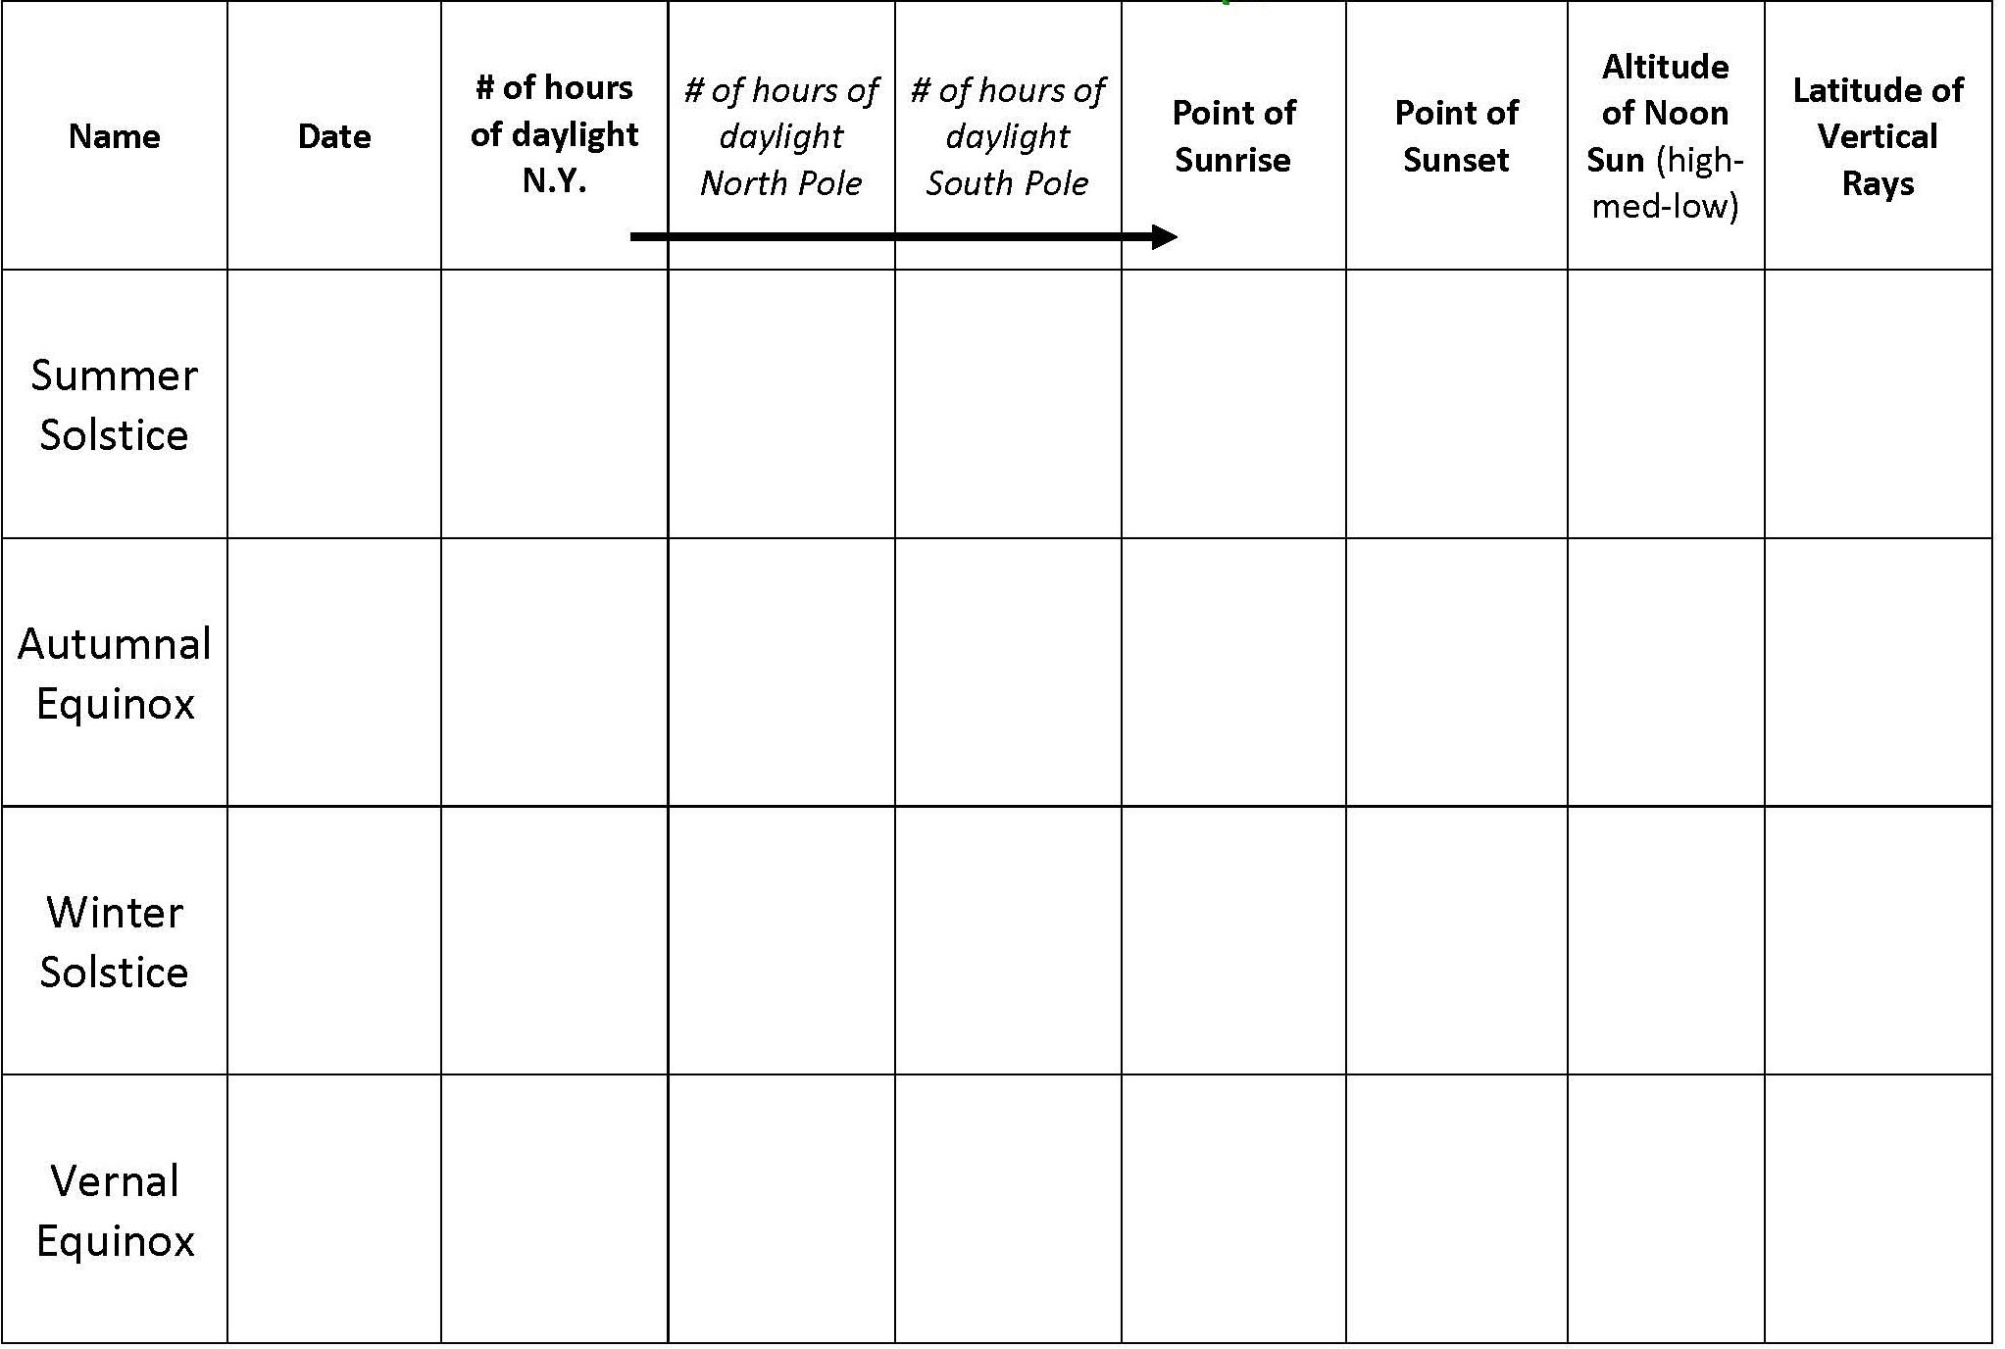

Slide 56
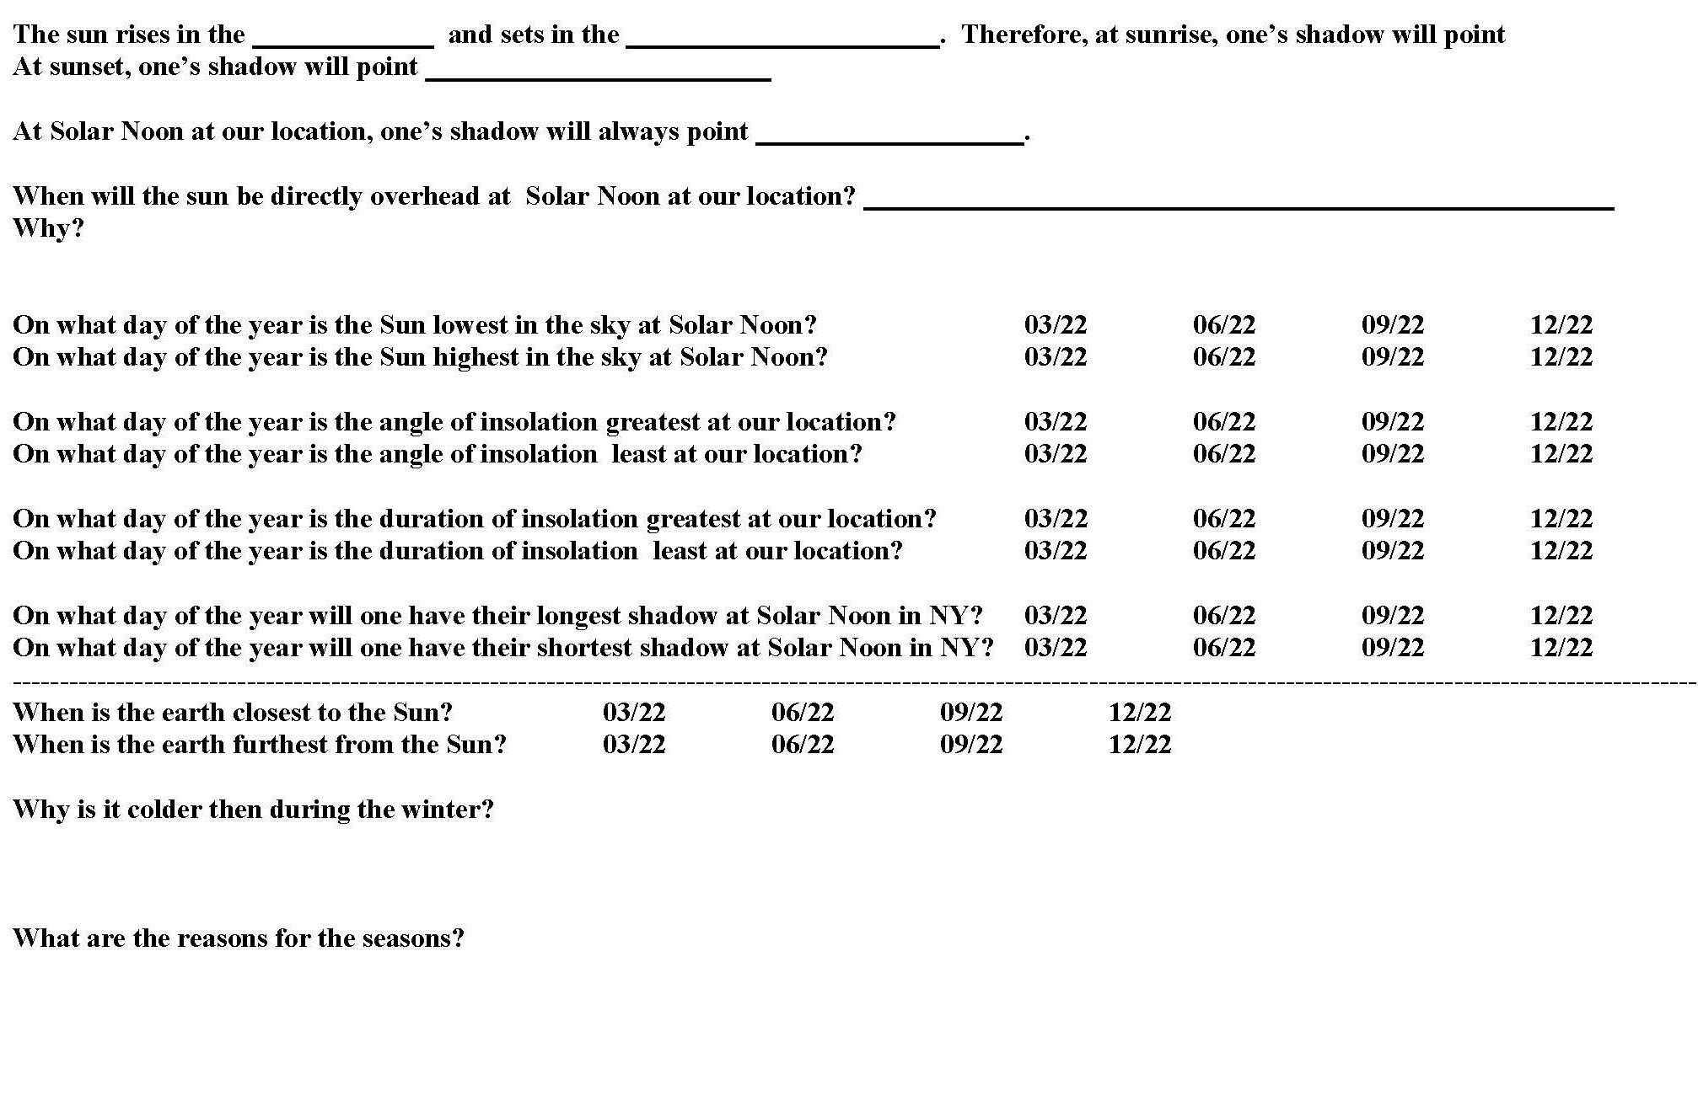

Slide 57
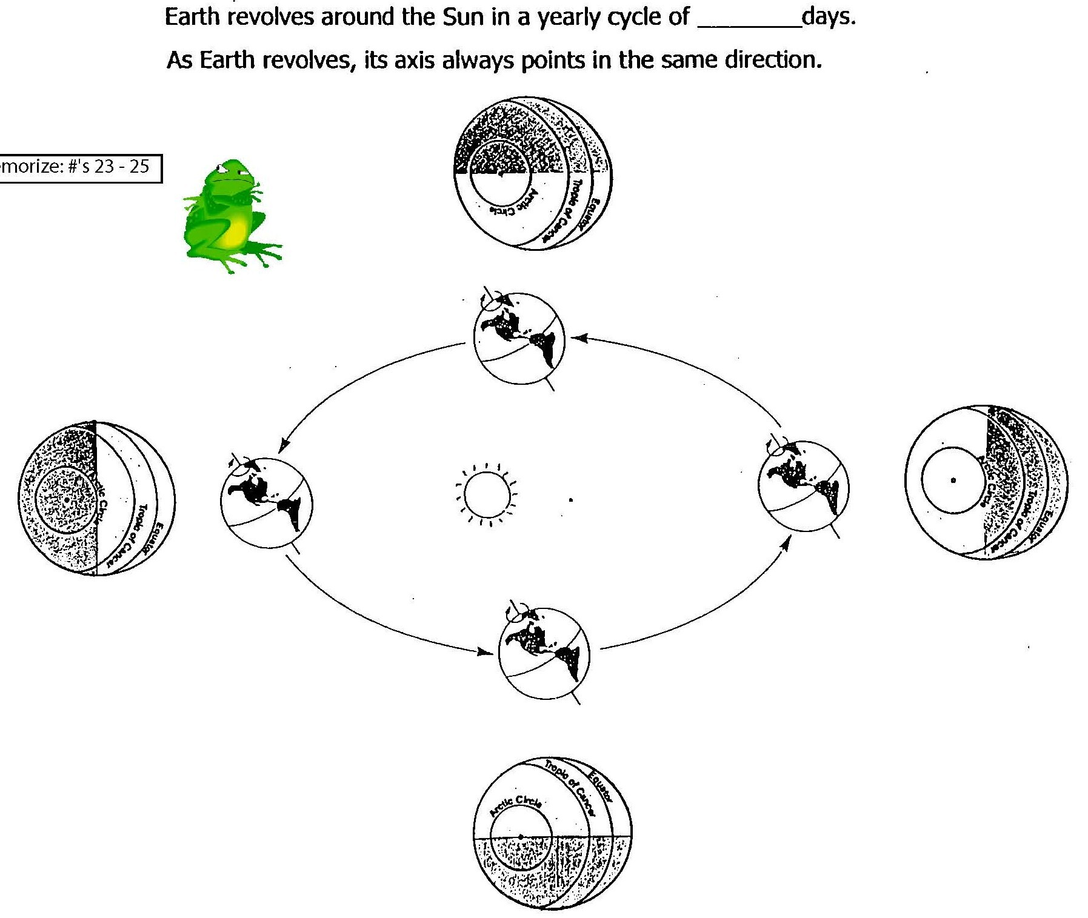
365

Slide 58
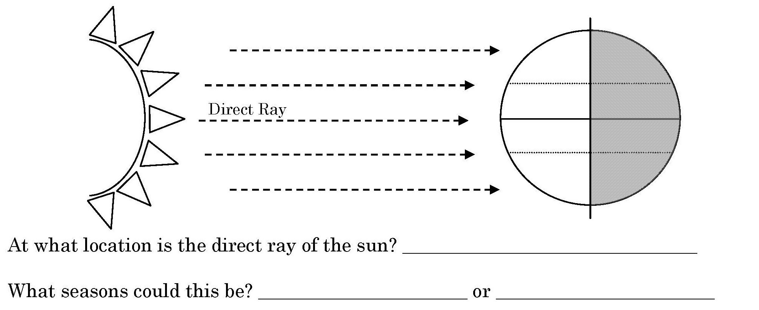
Angle of Insolation/ Angle of Incidence
Equator
Spring
Fall

Slide 59
Angle of Insolation/ Angle of Incidence
Tropic of Capricorn
Winter

Slide 60
Angle of Insolation/ Angle of Incidence
Tropic of Cancer
Summer

Slide 61
Number of hours of sunlight.
*Tilt and Revolution
Latitude
Time of Year (season)
12 hours of daylight everyday, no seasons
Longer days = warmer temps.
Shorter days = cooler temps.

Slide 62
Draw the path of the Sun across the sky for each of the dates of the equinoxes and solstices for NY State.

Slide 65
End

Slide 69
In the Northern hemisphere use June as a starting month. Determine if the noon sun is higher or lower in the sky than the Tropic of Cancer. Follow the procedure below.

Slide 71
Angle of Insolation Depends on 3 things
Time of Day
Lowest angle of Insolation = cooler
Highest angle of Insolation = warmer
Lowest angle of Insolation = cooler

Slide 72
Latitude
- At the equator there are more direct rays of sunlight = higher angle of incidence.

Slide 73
Time of Year
- Summer time the sun is highest in the sky = greatest angle of insolation.

